Slide 1
Veer Narmad South Gujarat University, Surat.
Department of Information and Communication Technology
B.Sc. (Information Technology)
Project Report
6th Semester
M.Sc. (Information Technology)
5 Years Integrated Course
Year: 2025-2026
Legal Case Management System
External Guide:
Internal Guide:
Dr. Parul Patel
Submitted by:
Pathan Samir
SPID : 2023040294
Rangoonwala Manan
SPID : 2023040309
Talior Utsav
SPID: 2023040337
MOUNTAINSDRIVEN TECHNOLOGIES
437, Shiven Square , Nr. Blu life , Pal
Surat, Gujarat 395009

Slide 2

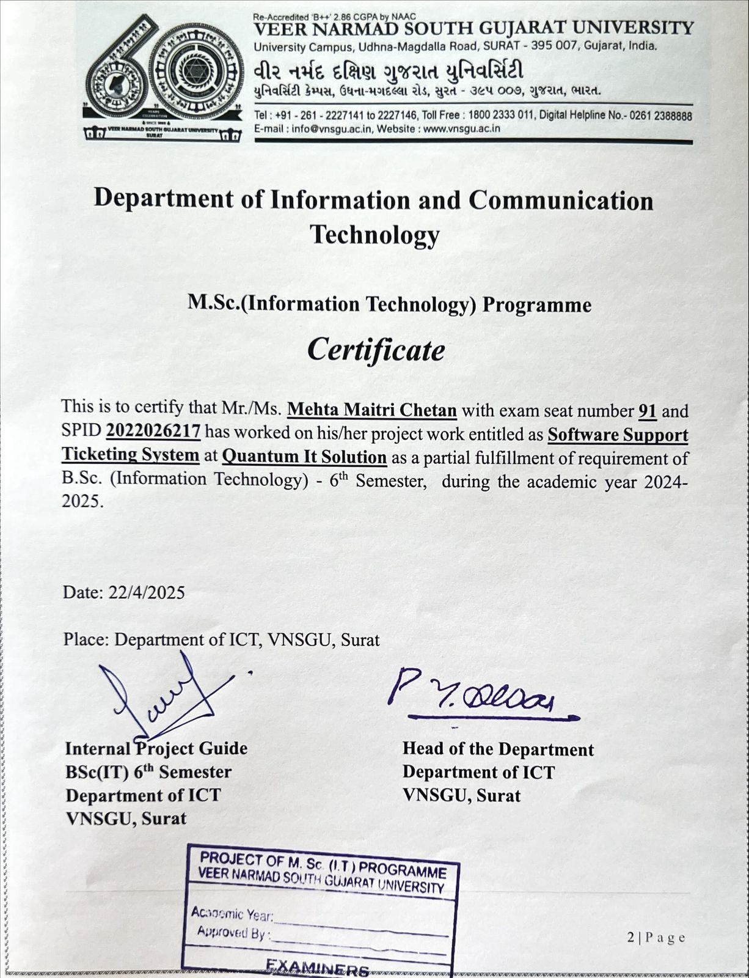
Software Support Ticketing System

Slide 3
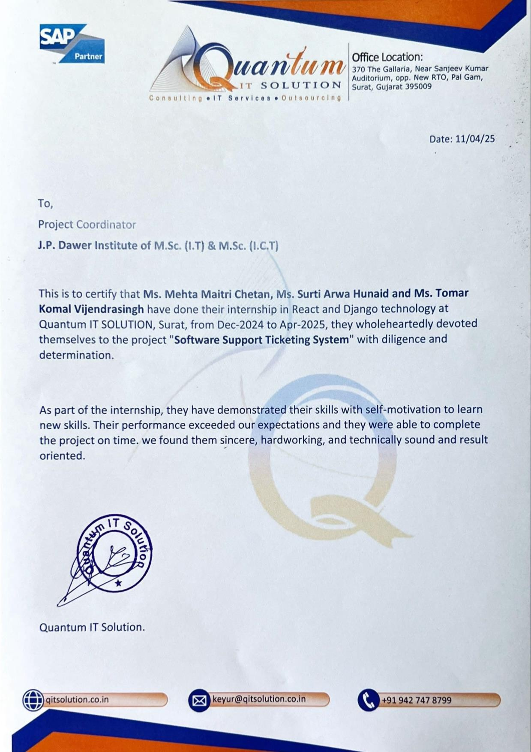
Software Support Ticketing System

Slide 4
Software Support Ticketing System
Table of Contexts
Project Overview
Key stakeholders 05
Scope 06
Objectives 08
01
02
System Environment
Technology Description 12
Software Requirements 13
03
System Planning
Feasibility Study 14
Software Engineering Model 15
Software Requirements Specification
Functional Requirements 18
Non-Functional Requirements 19
Entity-Relationship Diagram 21 UML Diagram
Use-case Diagram 22
Class Diagram 23
Activity Diagram 24
Sequence Diagram 25
Data Flow Diagram 29
04
05
06
07
08
09
Data Dictionary 33 Software Design
Database Design 36
Interface Design 47
10
11
12
Testing 126 Future Enhancement 128 Bibliography 129

Slide 5
Legal Case Management System
​Project Overview
The Legal Case Management System (LCMS) is a comprehensive, web-based application designed to streamline and manage legal case processes efficiently. This system helps lawyers, clients, and administrators to handle case-related activities such as case registration, document management, hearing schedules, and status tracking in a centralized platform.
The system improves communication, reduces paperwork, and ensures transparency between legal professionals and clients. It also enhances productivity by automating routine tasks and maintaining secure digital records of all legal proceedings.
Basic Information:~
Project Title | Legal Case Management Case
Organization | Moutainsdriven technologies
FrontEnd Tools | HTML, CSS, JavaScript
BackEnd Tools | Python (Flask)
Database | MongoDB
Cloud | Local Server
Project Category | Web Based Application
Duration | 3 Months
Internal Project Guide | Dr. Parul Patel
External Project Guide
Submitted By | Pathan Samir Rangoonwala Manan Tailor Utsav
Submitted To | Department of ICT, VNSGU
Key Stakeholders
Law Firm / Legal Organization: The main entity responsible for managing legal cases, maintaining records, and providing legal services to clients. This organization uses the system to streamline operations and improve case handling efficiency.
Clients (Individuals / Organizations): People or companies who seek legal assistance. They use the system to register cases, upload documents, track case progress, and communicate with lawyers.
Users (Lawyers / Advocates): Legal professionals who handle cases assigned to them. They are responsible for updating case details, managing documents, scheduling hearings, and providing legal updates to clients.
Admin (System Administrator): The authority who manages the entire system. The admin controls user access, assigns cases to lawyers, maintains the database, and ensures smooth functioning of the system.

Slide 6
Legal Case Management System
1.2 Scope
Legal Case Management System is a comprehensive platform designed to streamline legal operations, case tracking, client management, and workflow automation for law firms, legal departments, and courts. The system enables efficient collaboration between Admins, Lawyers, Staff, and Clients through role-based access and centralized data management.
Core Features in Scope:
User Management
Admin registration and system control
Lawyer, Staff, and Client account creation
Secure login system with role-based access
Authentication with OTP/email verification
Case Management
Case creation with client details
Case categorization (case type, status, priority)
Assignment of cases to lawyers and staff
Case progress tracking and updates
Hearing date scheduling and reminders
Hearing Management
Schedule and manage court hearings
Calendar view for upcoming hearings
Automatic status updates based on hearing outcomes
Notifications for upcoming dates
Document Management
Upload and manage legal documents
Secure file storage and access control
Document version tracking
Download and preview functionality

Slide 7
Legal Case Management System
Judgement & Reports
Upload and track judgement details
Case-wise report generation
PDF/Excel export for hearings and cases
Historical data tracking
Activity & Notes Tracking
Maintain detailed activity logs per case
Add notes/comments with timestamps
Attach supporting files to notes
Track user actions for auditing
Notifications
System-generated alerts (case updates, hearings, document uploads)
Role-based notifications (Admin, Lawyer, Client, Staff)
Real-time updates within dashboard
Search & Filtering
Search cases by client name, case ID, status
Filter by lawyer, date, priority, or case type
Quick access to recent or active cases
Dashboard & Analytics
Role-based dashboards (Admin, Lawyer, Staff, Client)
Case statistics and summaries
Visual insights (open cases, closed cases, upcoming hearings)
Communication Module
Internal communication between lawyers and staff
Client updates regarding case progress
Optional SMS for notifications

Slide 8
Legal Case Management System
1.3 Objectives
Our objective is to develop a web-based Legal Case Management System (LCMS) that enables Admins, Lawyers, Staff, and Clients to efficiently manage legal cases, track hearings, handle documents, and streamline communication while ensuring transparency, security, and timely case resolution.
Role-Based System Functionality
1. Admin Objectives
Admins have complete control over the system, ensuring smooth legal operations, user management, and overall system monitoring..
User & Role Management
Create, update, and manage Lawyers, Staff, and Clients
Assign roles and define permissions based on responsibilities.
Case Supervision & Assignment
Monitor all cases across the system.
Assign or reassign cases to lawyers and staff.
Ensure cases are progressing on time.
System & Data Management
Manage case categories, types, and statuses.
Maintain centralized database of cases and users.
Generate reports for case performance and workload analysis.
Monitor system activity logs for transparency
Security & Authentication
Enforce role-based access control (RBAC) to restrict unauthorized access.
Manage secure login and authentication.
Ensure data privacy and secure document handling.

Slide 9
Legal Case Management System
Lawyer Objectives
Lawyers focus on managing assigned cases, tracking progress, and handling legal documentation efficiently.
Case Handling
View and manage assigned cases.
Update case status and progress.
Schedule and track hearing dates.
Document Management
Upload and manage case-related documents.
Access client and case files securely.
Client Interaction
Communicate case updates to clients.
Add notes and maintain case history.
Staff Objectives
Staff assist lawyers and admins in maintaining records and managing daily operations.
Operational Support
Assist in case data entry and updates.
Manage hearing schedules and reminders.
Maintain documentation and records.
Coordination
Coordinate between lawyers and clients.
Ensure timely updates of case activities.

Slide 10
Legal Case Management System
4. Client Objectives
Clients can track their legal cases and stay informed about progress.
Case Tracking
View case details and current status.
Track hearing dates and updates.
Document Access
Access uploaded legal documents.
Download important case files.
Communication
Receive updates and notifications about their cases.
Stay informed about progress and outcomes.
5. System-Wide Objectives
Ensure efficient case lifecycle management.
Provide real-time updates and notifications.
Maintain accurate logs and audit trails.
Improve transparency and accountability in legal processes.
6. Security & Compliance
Role-based access control (RBAC) restricts unauthorized access.
10 | P a g e

Slide 11
Legal Case Management System
Tickety ensures a streamlined, role-based workflow where:
Admins manage users, employees, tickets, and system operations.
Users/Employees handle tickets, ensuring efficient resolution.
Customers can only create tickets and manage their profiles.
This structured approach allows for efficient ticket resolution, accountability, and transparency
in issue tracking.
11 | P a g e

Slide 12
Legal Case Management System
​System Environment:
The Legal Case Management System is designed to be used by multiple users such as Clients, Lawyers, Admins, and Staff simultaneously. A stable internet connection is required for smooth functioning of the web-based application.
The system consists of the following main components:
Client Panel
A web-based interface where clients can Register and log in securely (including Google login) ,View their legal cases ,Track case status and upcoming hearings ,Receive notifications related to case updates
Lawyer Panel
A web-based interface for lawyers to View and manage assigned cases ,Update case details and status ,Schedule hearings and manage legal documents ,Track client-related activities
Admin Panel
A centralized interface where administrators can Manage users (clients, lawyers, staff) Assign cases to lawyers ,Monitor overall system activity ,Handle reports, notifications, and system control
Staff Panel
A support interface for staff members to Assist in managing case records ,Upload and organize documents ,Help maintain smooth system operations
Technology Description:
Frontend Language:
HTML, CSS, JavaScript
UI Components : Custom CSS is used to create a clean responsive and user-friendly interface, Ensures smooth navigation for different users like admin ,lawyer, client and staff.
Backend Language:
Python
Database Management : MongoDB is used for data storage

Slide 13
Legal Case Management System
2.2 Software Requirements:
Operating System: | Windows, Linux, macOS
Programming Languages: | Python, HTML, CSS, Java script
Database Management System: | MongoDB
Web Browsers: | Google Chrome, Microsoft Edge, Mozilla Firefox

Slide 14
Legal Case Management System
​System Planning
Feasibility Study:
The problem of inefficient manual handling of legal cases, documents, and hearing schedules is analyzed, and a feasibility study is conducted to assess the practicality of developing the Legal Case Management System. The feasibility report focuses on the following three areas:
Technical Feasibility:
The Legal Case Management System is developed using a client-server architecture. The backend is implemented using Flask (Python), while the frontend is built using HTML, CSS, and JavaScript for a responsive user interface. The system uses MongoDB for secure and flexible data storage of cases, users, hearings, and documents.
Operational Feasibility:
The system provides a simple and user-friendly interface for different users such as Admin, Lawyer, Client, and Staff.
Clients can register, log in, view their cases, and track hearing dates
Lawyers can manage assigned cases, update case status, and add hearings
Admins can control users, assign cases, and monitor system activities
Staff can assist in managing records and operations
Economic Feasibility:
The development cost of the Legal Case Management System is minimized by using open-source technologies such as Flask, MongoDB, and standard web technologies.
The system reduces:
-Manual paperwork
-Time required for case tracking
-Human errors in scheduling and record management
Technical Feasibility ,Operational Feasibility ,Economic Feasibility

Slide 15
Legal Case Management System
3.2 Software Engineering Model
The Legal Case Management System was developed using the Agile model, enabling iterative development, continuous feedback, and regular improvements throughout the project lifecycle. The development process was organized into multiple sprints, beginning with requirement gathering and system planning, followed by modular development of features such as user authentication, case management, hearing scheduling, and notification handling. Each sprint included testing and review phases to ensure quality and functionality. Regular feedback helped refine the system, and a final integrated release ensured a stable and efficient legal case management platform.
Product Vision and Backlog Creation
Phase: Initial Planning and Requirement Gathering
Description: This phase focuses on defining the overall vision of the Legal Case Management System, identifying different user roles such as Admin, Lawyer, Client, and Staff, and determining the key functionalities like case management, hearing scheduling, document handling, and notifications. A structured backlog is created with prioritized user stories to guide development.
Activities:
Stakeholder Meetings
Requirement Gathering
Feature Identification (case tracking, hearing, documents, etc.)
Backlog Creation and Prioritization
Initial Effort Estimation
Sprint-Based Iterative Development
Phase: Agile Sprints (Time-Boxed Iterations)
Description: The development process is divided into multiple sprints, where each sprint focuses on delivering specific modules such as authentication, case management, hearing scheduling, or notification systems.
Activities (For Each Sprint):
Sprint Planning
Daily Scrum
Development (e.g., login ,dashboard ,case module)
Unit Testing
Integration Testing
Sprint Review and Feedback Loop
Phase: Evaluation and Continuous Feedback
Description: After each sprint, working features are demonstrated to stakeholders. Feedback is gathered, bugs and enhancement requests are noted and added to the backlog. At the end of each sprint, the developed features are demonstrated to stakeholders. Feedback is collected regarding usability, performance, and functionality.
Activities:
Sprint Review Meeting

Slide 16
Legal Case Management System
Feature Enhancement Planning
Retrospective
Backlog Updates
Final Release and System Testing
Phase: Pre-Deployment and Release
Description: In the final phase of the Legal Case Management System, all developed modules such as user authentication, case management, hearing scheduling, document handling, and notification system are fully integrated.
Activities:
Final Integration of all modules
System Testing (end-to-end workflow validation)
Performance Testing
User Acceptance Testing (UAT)
Deployment Preparation and Final Release
Project Iterations in Detail
Sprint 1: Authentication and Admin Setup
Objective: Implement user authentication and super administrative control for the system.
Activities:
Setup login, registration, and logout functionality
Admin panel to manage user (client, lawyer, staff)
Role-based access control (admin, lawyer, client, staf
Unit testing and staging deployment
Sprint 2: Ticket Lifecycle and Customer Portal
Objective: Enable clients to create, view, and track their legal cases
Activities:
Case creation and assignment functionality
View case details and current status
Display assigned lawyer information
Client dashboard implementation
Sprint 3: Employee Dashboard and Activities Tracking
Objective: Empower lawyers to manage cases and handle legal activities efficiently.

Slide 17
Legal Case Management System
Activities:
Lawyer dashboard to view assigned cases
Add notes and update case progress/status
View complete case history
Internal notifications and activity tracking for updates
Sprint 4: Admin Reports, Configurations & Final Testing
Objective: Provide administrative control, analytical insights, and ensure final system validation before deployment.
Activities:
Admin report generation
System configuration and management
Integration of all modules
System testing and bug fixing

Slide 18
Legal Case Management System
Software Requirement Specification (SRS)
Functional Requirements :
User Authentication
Users must log in using email or via Google OAuth Login
Secure session management must be implemented.
New users must register before accessing the system.
Passwords must meet security criteria (minimum length, special characters, etc.).
Case Management
Users can create or update case details, but deletion is not allowed.
Admins can assign or reassign cases to lawyers.
Users can attach files/images to cases.
Status updates: Open, Resolved, Closed.
Each case includes:
Case title and description
Client and assigned lawyer details
Case status (Open, Pending, Closed)
Lawyers can update case progress and add notes.
Clients can view their case status and assigned lawyer information.
Case search and filtering based on status, lawyer, or client..
Hearing Management
Lawyers or admins can schedule hearings for cases.
Upcoming hearings are displayed in dashboards.
Users can view hearing history and updates.

Slide 19
Legal Case Management System
Dashboard & Analytics
Real-time dashboard displaying:
Total cases (Open, Pending, Closed)
Number of active hearings
Case distribution by lawyer and client
Filters for viewing cases based on:
Date range
Assigned lawyer
Case status
Notifications
Users receive:
Message alerts for:
Case updates
Hearing schedules
4.2 Non-functional Requirements:
Performance
The system should support multiple concurrent users (clients, lawyers, admin, staff).
Real-time updates for case status and hearing schedules.
Efficient handling of large datasets (cases, documents, hearings).
2. Security
Role-Based Access Control (RBAC) ensures authorized access to features.
Secure session handling to prevent unauthorized access.
Sensitive data must be protected during storage and transmission.
Integration of secure authentication methods such as Google OAuth login.

Slide 20
Legal Case Management System
Usability
The system provides a fully responsive user interface compatible with both desktop and mobile devices.
Clean and structured design ensures easy readability and navigation.
User-friendly dashboards for clients, lawyers, admin, and staff.
Availability
The system is designed to ensure high availability and reliability.
Supports continuous operation with minimal downtime.
Capable of recovering from minor failures automatically
Maintainability
Built using a modular architecture (Flask + MongoDB ) for easy maintenance and updates..
Code structure allows developers to update individual modules without affecting the entire system.
Logging mechanisms are implemented to monitor system performance and errors.
Regular updates and improvements can be applied efficiently.
Compliance & Regulations
User data is handled securely with proper privacy measures.
Role-based access ensures restricted and authorized data usage.
Data retention policies can be applied for storing case records and logs appropriately.
Prevents unauthorized access through authentication and secure session handling.
20 | P a g e

Slide 21

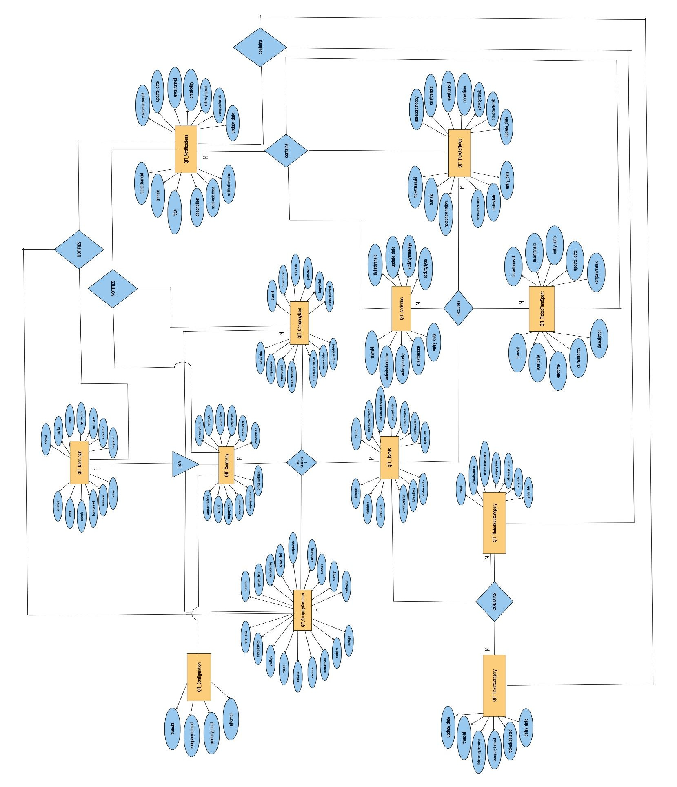
Software Support Ticketing System
5. Entity-Relationship Diagram of Software Support Ticketing System
M
21 | P a g e

Slide 22
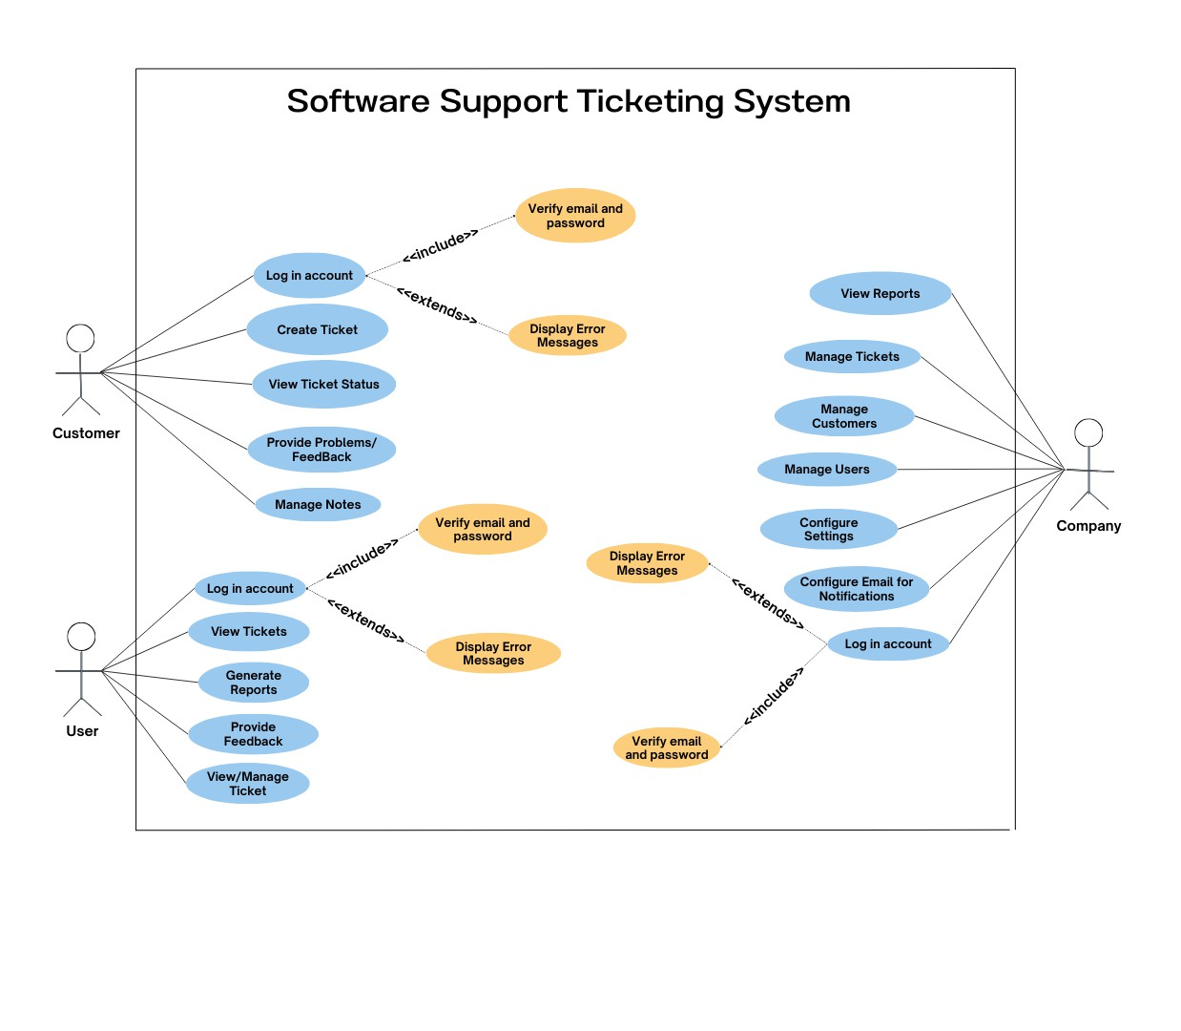
Software Support Ticketing System
6.1 Use Case Diagram of Software Support Ticketing System
Employee
22 | P a g e

Slide 23

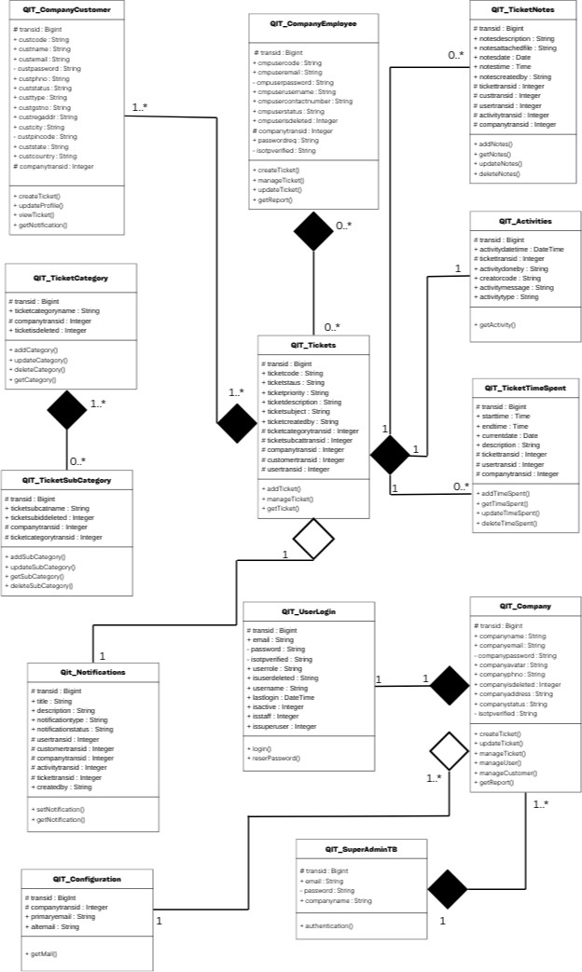
Software Support Ticketing System
6.2 Class Diagram of Software Support Ticketing System

Slide 24
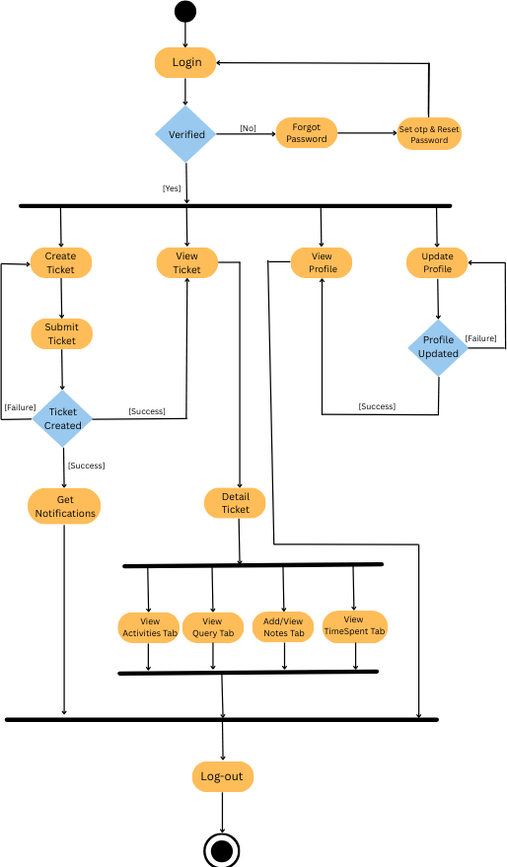
Software Support Ticketing System
6.3 Activity Diagram of Software Support Ticketing System

Slide 25
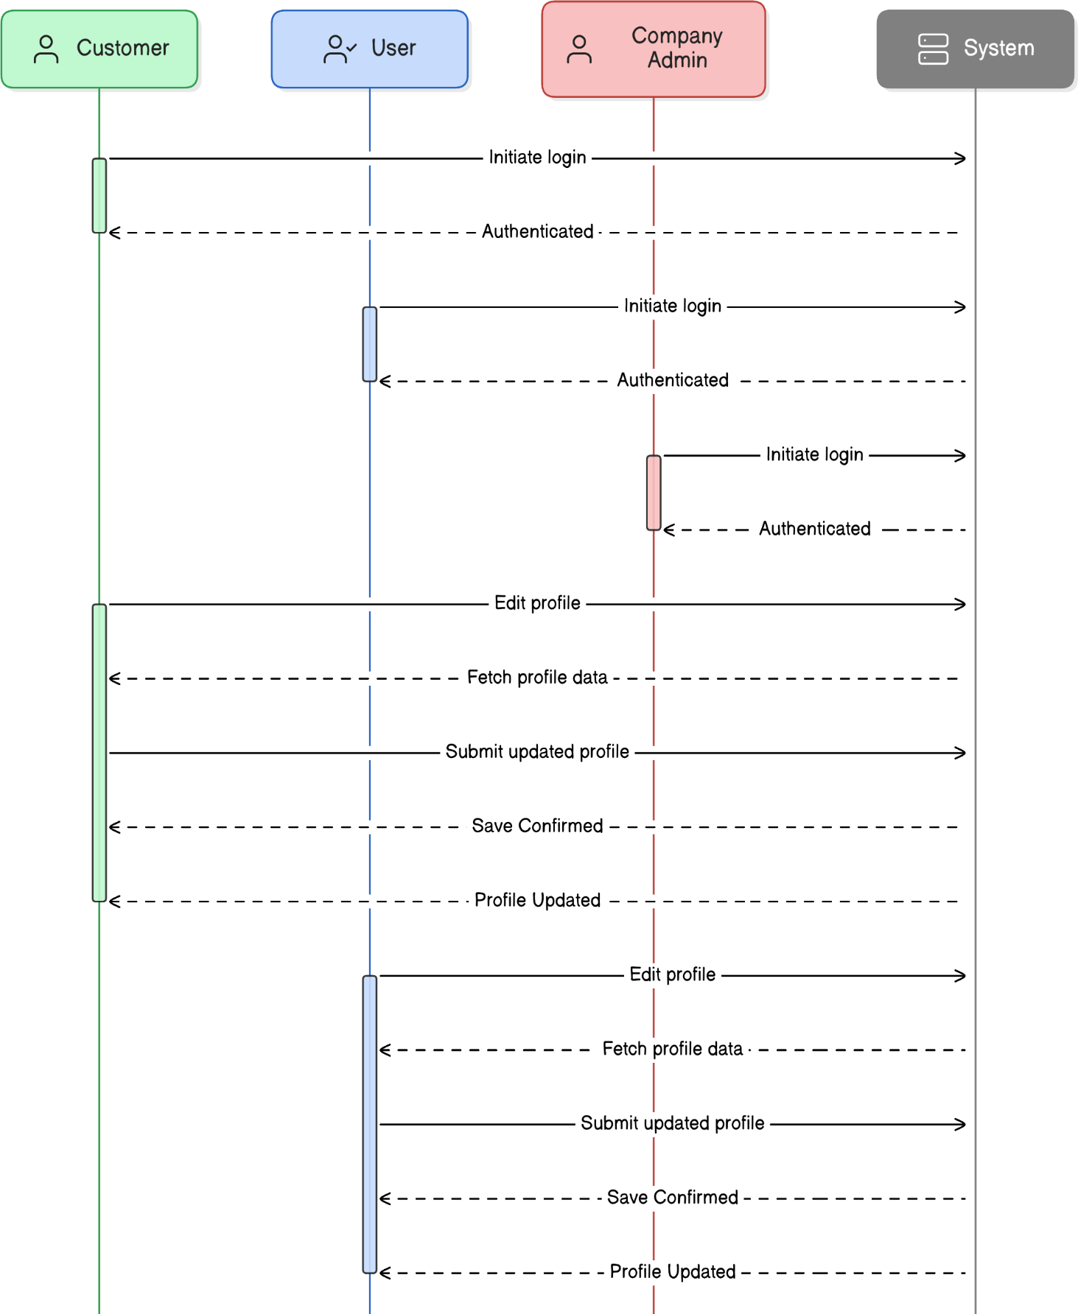
Software Support Ticketing System
6.4 Sequence Diagram of Software Support Ticketing System

Slide 26

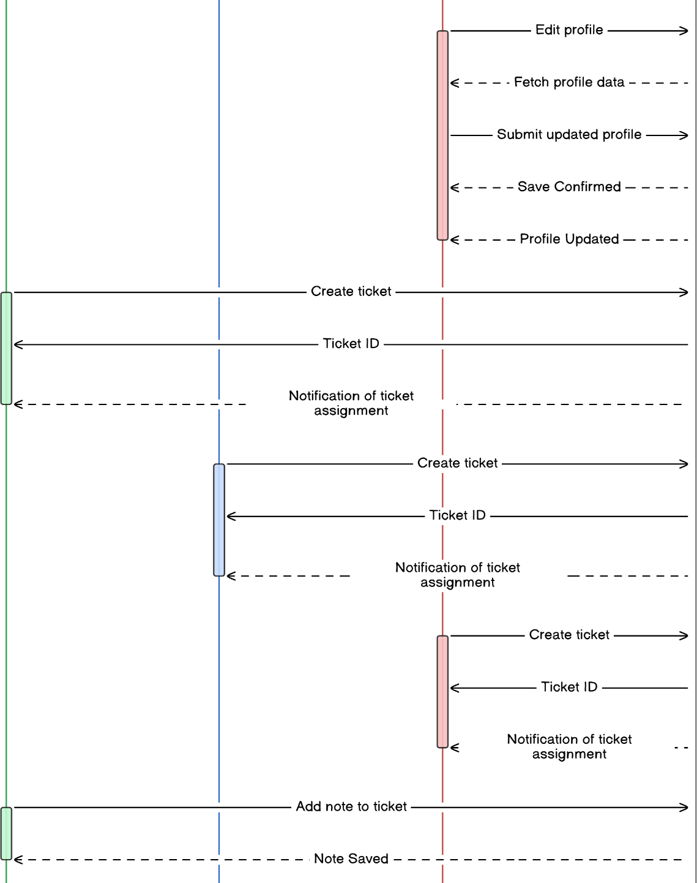
Software Support Ticketing System
6.4 Sequence Diagram of Software Support Ticketing System

Slide 27

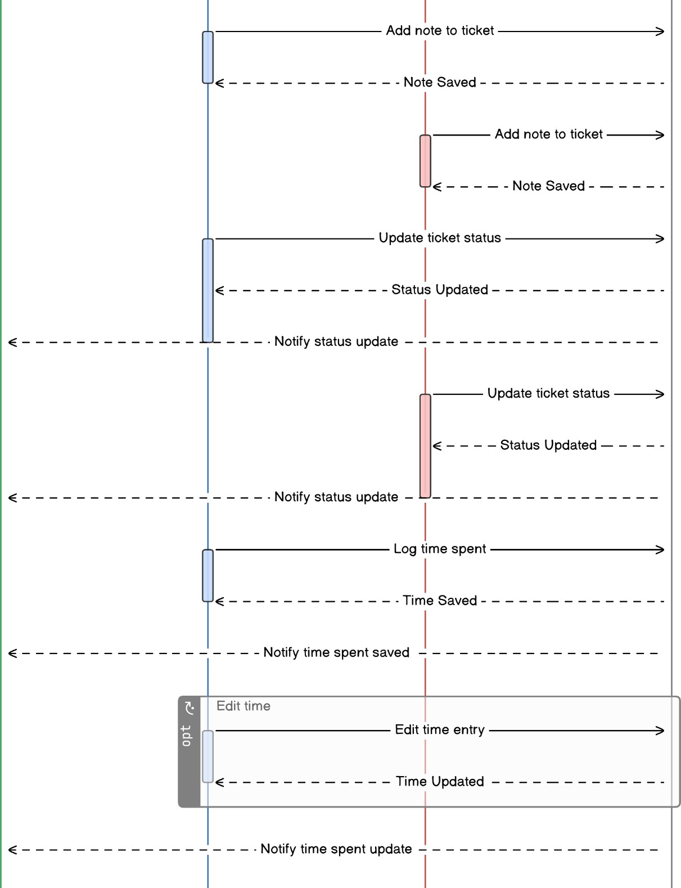
Software Support Ticketing System
6.4 Sequence Diagram of Software Support Ticketing System

Slide 28
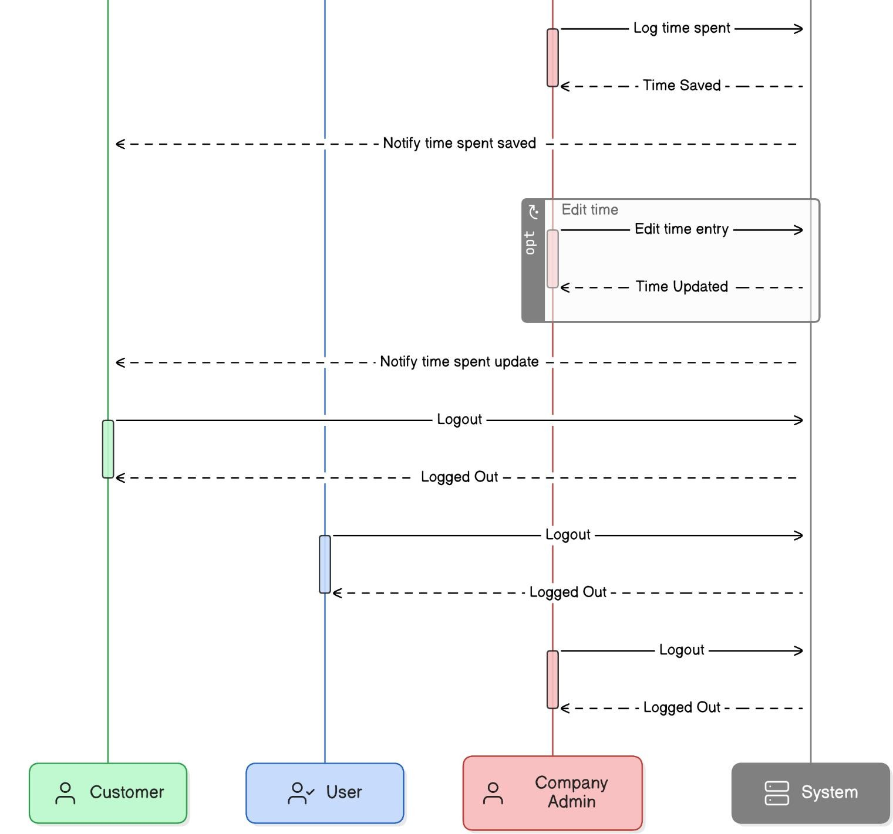
Software Support Ticketing System
6.4 Sequence Diagram of Software Support Ticketing System

Slide 29
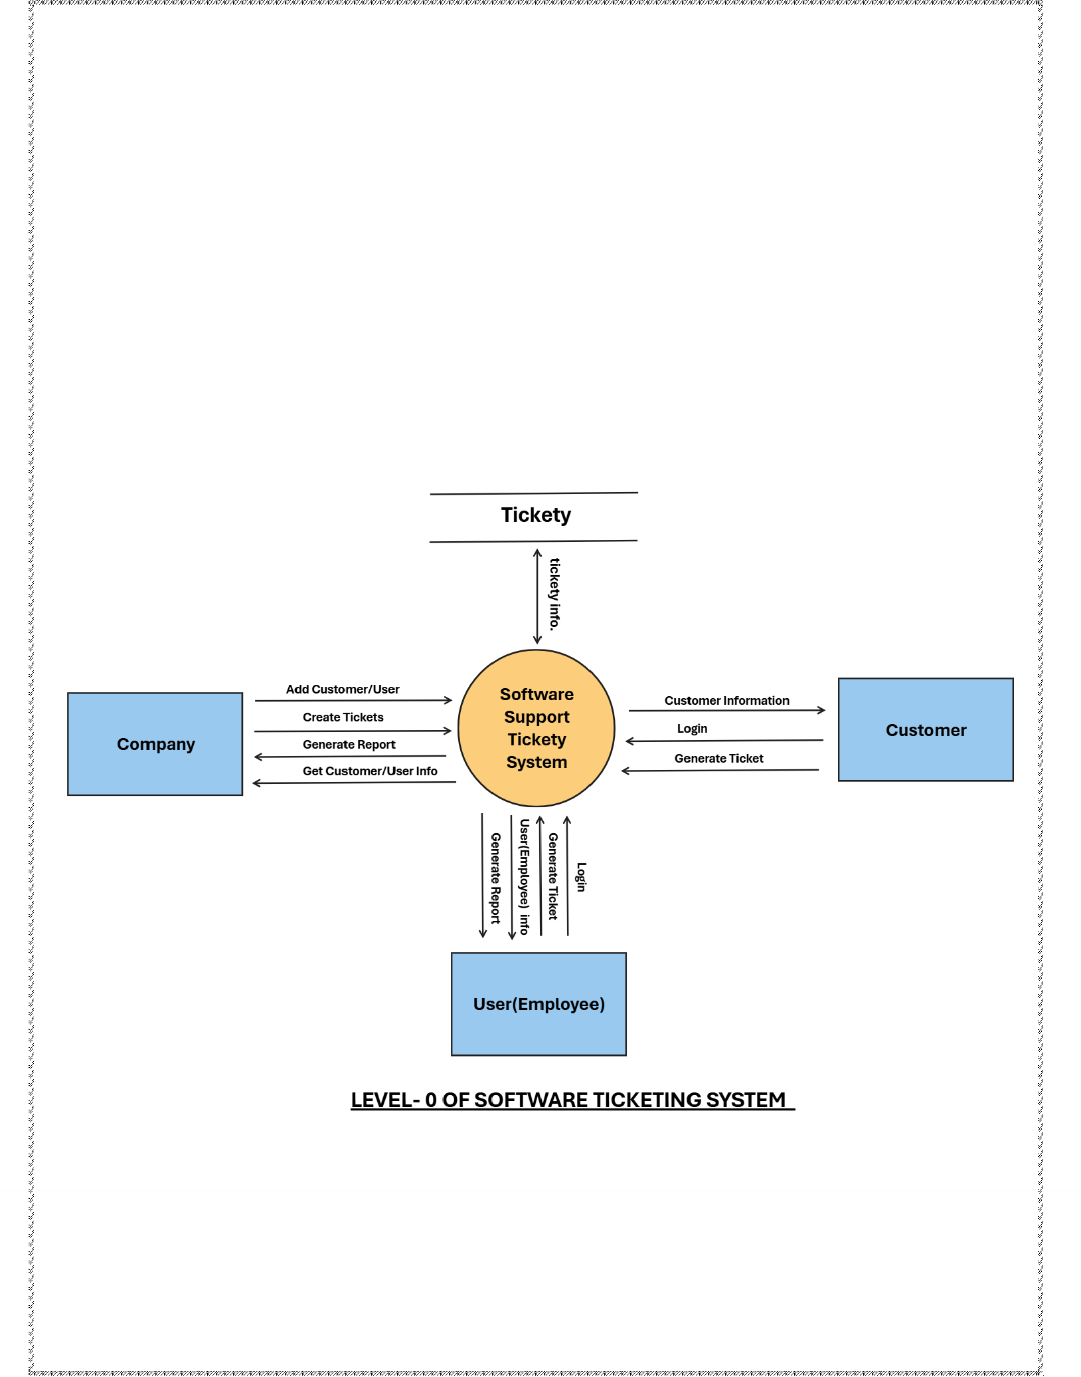
Software Support Ticketing System
7. Data Flow Diagram for Software Support Ticketing System
1. Level-0

Slide 30
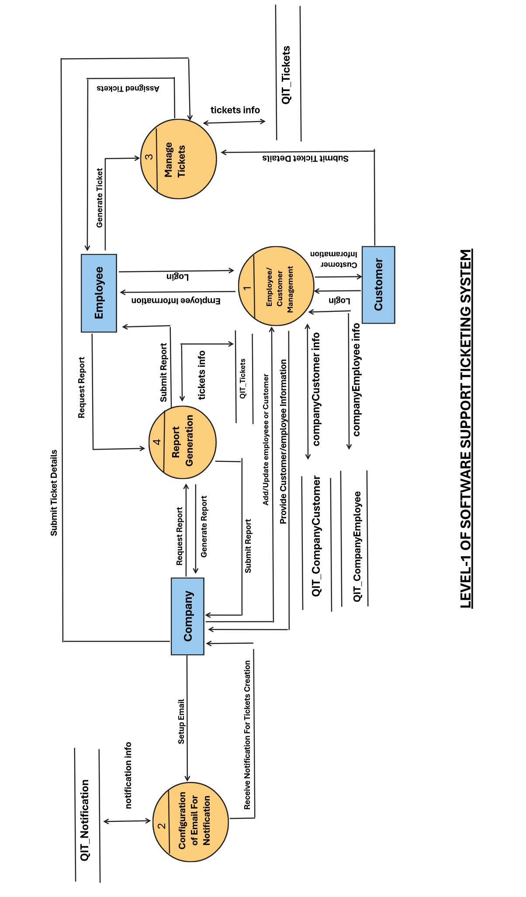
Software Support Ticketing System
2. Level-1
30 | P a g e

Slide 31
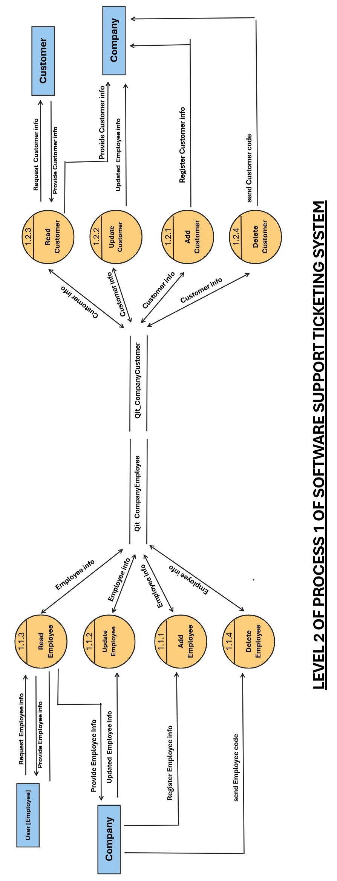
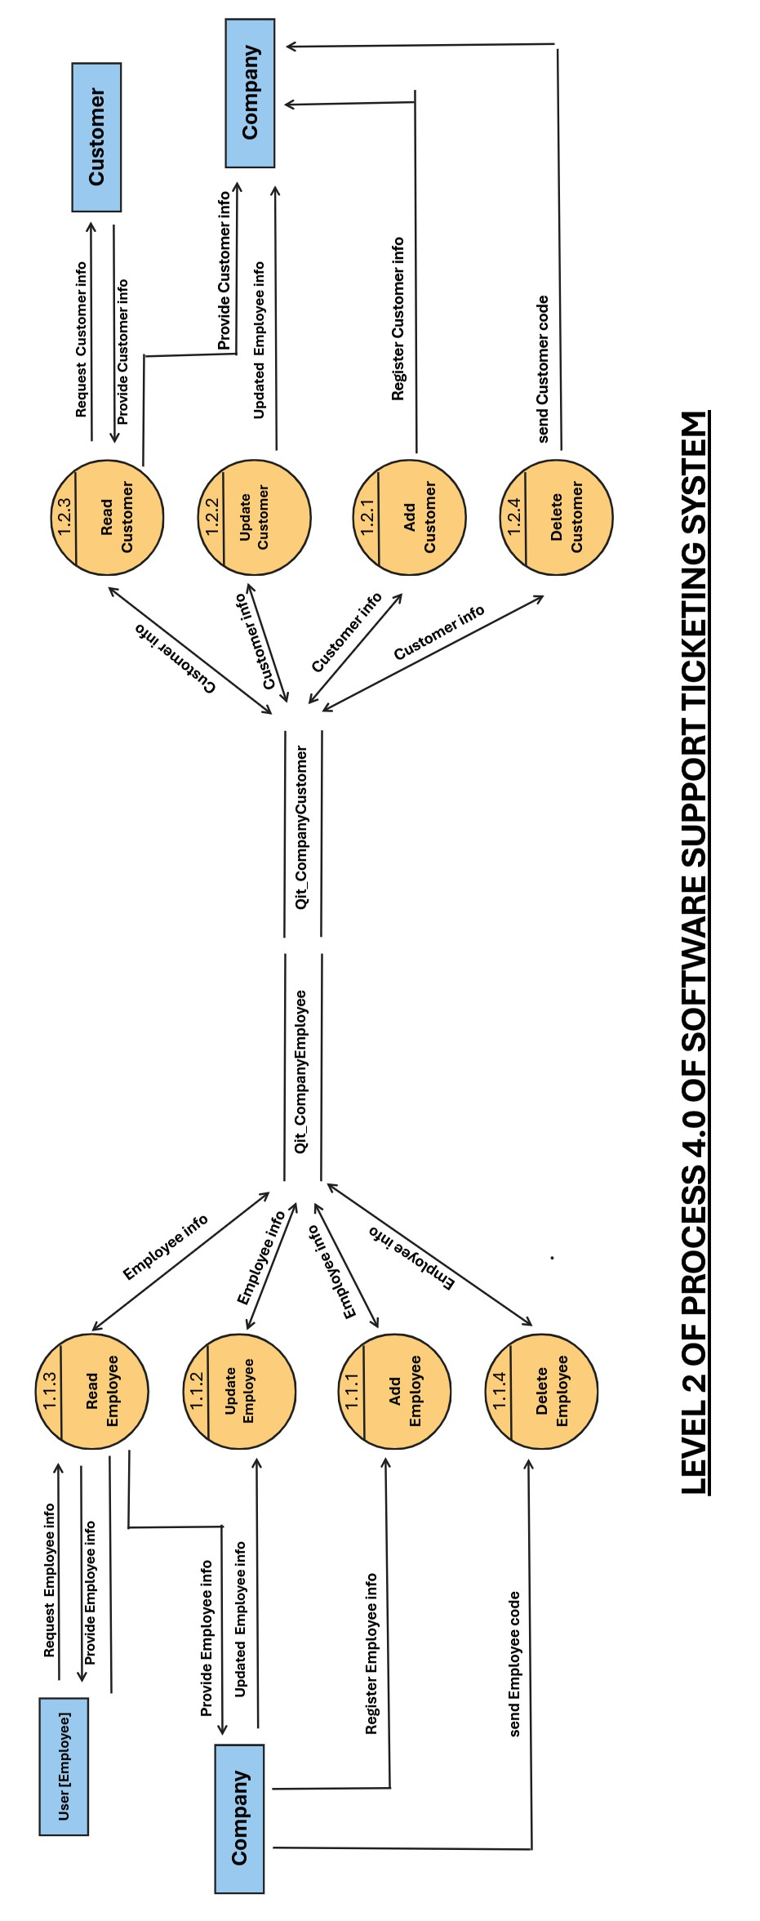
Software Support Ticketing System
Level-2

Slide 32
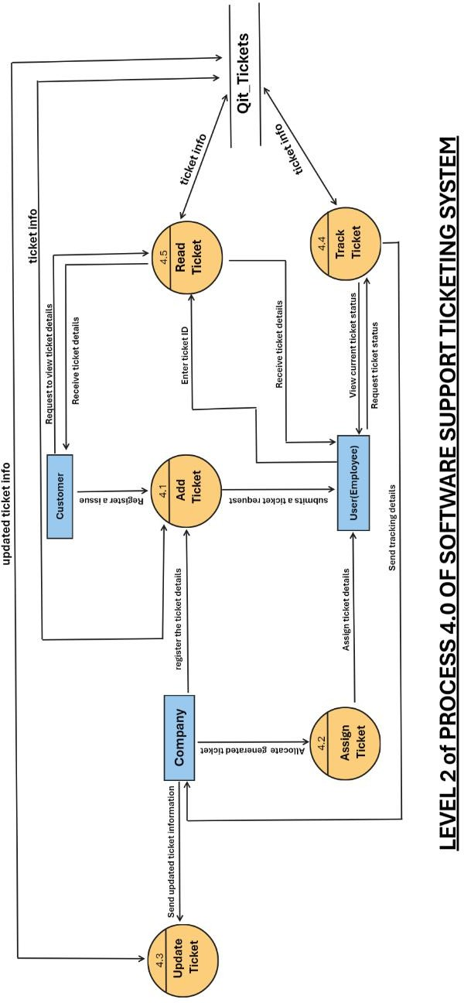
Software Support Ticketing System

Slide 33
Software Support Ticketing System
8. Data Dictionary
1) QIT_CompanyCustomer
Name | QIT_CompanyCustomer
Alias | Customer Master
Where & how to use | Used during customer registration, login, and company-wise mapping.
Description | Stores all details of the customer including credentials, profile, location, company linkage, and activity flags.
2) QIT_Company
Name | QIT_Company
Alias | Company Master
Where & how to use | Used while registering and managing companies. Links to customers, employees, categories, etc.
Description | Company-level data including contact, avatar, login, and OTP verification. Serves as parent to various modules.
3) QIT_CompanyEmployee
Name | QIT_CompanyEmployee
Alias | Internal Company Users
Where & how to use | Used for login/authentication and management of internal users linked to companies.
Description | Holds company user data such as credentials, status, and employee profile with company linkage.
4) QIT_SuperAdminTB
Name | QIT_SuperAdminTB
Alias | Admin Credentials
Where & how to use | Used for super admin login and platform-level control.
Description | Contains super admin credentials and metadata for system-wide control.

Slide 34
Software Support Ticketing System
5) QIT_TicketCategory
Name | QIT_TicketCategory
Alias | Ticket Group
Where & how to use | Used to group tickets by category for each company.
Description | Master list of categories used to classify support tickets per company.
9. QIT_TicketSubCategory
Name | QIT_TicketSubCategory
Alias | Ticket Type
Where & how to use | Sub-division of ticket categories used in ticket creation.
Description | Defines sub-level categories under each ticket category to allow detailed ticket classification.
10. QIT_Tickets
Name | QIT_Tickets
Alias | Ticket Register
Where & how to use | Used for storing and tracking raised tickets by customers or company users.
Description | Stores full ticket lifecycle information like status, priority, category, created user, and timestamps.
11. QIT_Activities
Name | QIT_Activities
Alias | Ticket Actions
Where & how to use | Captures every action taken on a ticket for tracking.
Description | Records time-stamped activities done by users on tickets including status updates, communication, etc.
12. QIT_TicketNotes
Name | QIT_TicketNotes
Alias | Ticket Comments
Where & how to use | Notes/comments added against a ticket.
Description | Notes with optional file uploads created by users or customers against any ticket and activity.

Slide 35
Software Support Ticketing System
13. QIT_TicketTimeSpent
Name | QIT_TicketTimeSpent
Alias | Ticket Work Log
Where & how to use | Tracks time spent by support team or staff per ticket.
Description | Start time, end time, and notes describing time spent resolving or working on a ticket.
14. QIT_UserLogin
Name | QIT_UserLogin
Alias | Login Master
Where & how to use | Used for all types of login (admin, staff, customer) and role-based access control.
Description | Maintains login credentials, roles, and flags like is_active, is_staff, is_superuser, etc.
15. QIT_Notifications
Name | QIT_Notifications
Alias | System Alerts
Where & how to use | Used for real-time or stored notifications shown to users.
Description | Stores notification data linked with user/ticket/activity including title, message, and status.
16. QIT_Configuration
Name | QIT_Configuration
Alias | Company Settings
Where & how to use | Used to manage email config and other setup data per company.
Description | Configuration data such as primary email, alternate email, and reference to company for internal settings.

Slide 36
Software Support Ticketing System
Software Design
Database Design
1) QIT_CompanyCustomer
Element Name | Data Type | Constraint | Description
Transid | bigint | Primary Key | Unique id of customer
Custcode | varchar | Unique Key | Unique code of customer
custname | varchar | not null | Name of customer
Custemail | varchar | not null | Email of customer
Custpassword | varchar | not null | Password of customer
Custphno | varchar | null | Phone no of customer
Custstatus | varchar | null | Status of customer
Custtype | varchar | null | Status of customer
Custgstno | varchar | null | Type of customer
Custregaddr | varchar | null | Registered address of customer
Custcity | varchar | null | City of customer
Custpincode | varchar | null | Pincode of customer
Custstate | varchar | null | State of customer
Custcountry | varchar | null | Country of customer
Custlogo | longblob | null | Logo of customer’s company
Custisdeleted | integer | not null | Deletion flag for customer
companytransid | integer | Foreign Key | Transid of table QIT_Company
entry_date | datetime | datetime | Addition of customer date
update_date | datetime | datetime | Updation of customer date
Passwordreq | varchar | null | Password request of customer
Isotpverified | varchar | null | Otp verification of customer

Slide 37
Software Support Ticketing System
2) QIT_Company
Element Name | Data Type | Constraint | Description
transid | bigint | Primary Key | Unique id of customer
companyname | varchar | Not null | Name of company
companyemail | varchar | Not null | Email of company
companypassword | varchar | Not null | Password of company
companyavatar | longblob | null | Avatar(Base64 encoded image)
companyphno | varchar | null | Phone number of company
companyisdeleted | integer | Not null | Deletion flag of company
companyaddress | varchar | null | Address of company
entry_date | datetime | null | Entry date
update_date | datetime | null | Last update date
companystatus | varchar | null | Status of company
isotpverified | varchar | null | OTP verification flag of company

Slide 38
Software Support Ticketing System
3) QIT_CompanyEmployee
Element Name | Data Type | Constraint | Description
transid | bigint | Primary Key | Unique id of company user
cmpusercode | varchar | Unique Key | Unique code of company user
cmpuseremail | varchar | Not null | Email of company user
cmpuserpassword | varchar | Not null | Password of company user
cmpuserusername | varchar | Not null | Username of company user
cmpusercontactnumber | varchar | Null | Contact number of company user
cmpuserstatus | varchar | Null | Status of company user
cmpuserisdeleted | integer | Not null | Deletion flag of company user
companytransid | integer | Foreign Key | Transid of table QIT_Company
entry_date | datetime | Null | Entry date
update_date | datetime | Null | Last update date
Passwordreq | varchar | Null | Password request of company user
Isotpverified | varchar | Null | OTP verification flag of company user

Slide 39
Software Support Ticketing System
4) QIT_SuperAdminTB
Element Name | Data Type | Constraint | Description
transid | Bigint | Primary Key | Unique id of super Admin
email | varchar | Not null | Email of super Admin
password | varchar | Not null | password of super Admin
companyname | varchar | Not null | Company name of super Admin
entry_date | datetime | Not null | Entry date
update_date | datetime | Not null | Last update date
5) QIT_TicketCategory
Element Name | Data Type | Constraint | Description
transid | Bigint | Primary Key | Unique id of Ticket Category
ticketcategoryname | varchar | Null | Name of ticket Category
companytransid | integer | Foreign Key | Transid of table QIT_Company
ticketisdeleted | integer | Not Null | Deletion flag of ticket category
entry_date | datetime | Null | Entry date
update_date | datetime | Null | Last update date

Slide 40
Software Support Ticketing System
6) QIT_TicketSubCategory
Element Name | Data Type | Constraint | Description
transid | Bigint | Primary Key | Unique id of Ticket Sub-category
ticketsubcatname | varchar | Not Null | Name of Ticket Sub- category
ticketsubiddeleted | integer | Not Null | Deletion flag of ticket sub-category
companytransid | integer | Foreign Key | Transid of table QIT_Company
ticketcategorytransid | integer | Foreign Key | Transid of table QIT_ TicketCategory
entry_date | datetime | Null | Entry date
update_date | datetime | Null | Last update date
40 | P a g e

Slide 41
Software Support Ticketing System
7) QIT_Tickets
Element Name | Data Type | Constraint | Description
transid | Bigint | Primary Key | Unique id of Tickets
ticketcode | varchar | Not Null | Unique code of Tickets
ticketstaus | varchar | Not Null | Status of Tickets
ticketpriority | varchar | Null | Priority Tickets
ticketdescription | varchar | Null | Description of Tickets
ticketsubject | varchar | Null | Subject of Tickets
ticketcreatedby | varchar | Null | Name of company who generated Ticket
ticketcategorytransid | integer | Foreign Key | Transid of table QIT_ TicketCategory
ticketsubcattransid | integer | Foreign Key | Transid of table QIT_ TicketSubCategory
companytransid | integer | Foreign Key | Transid of table QIT_Company
customertransid | integer | Foreign Key | Transid of table QIT_CompanyCustomer
usertransid | integer | Foreign Key | Transid of table QIT_Companyuser
ticketdatetime | datetime | Not Null | Date of ticket generation
entry_date | datetime | Null | Entry Date
update_date | datetime | Null | Last update date

Slide 42
Software Support Ticketing System
8) QIT_Activities
Element Name | Data Type | Constraint | Description
transid | Bigint | Primary key | Unique id of Activities
activitydatetime | datetime | Not null | Entered activity date time
tickettransid | integer | Foreign Key | Transid of table QIT_ Ticket
activitydoneby | varchar | Null | Name of person who has attempted the activity
creatorcode | varchar | Null | Unique code of creator
entry_date | datetime | Null | Entry date
update_date | datetime | Null | Last update date
activitymessage | varchar | Null | Message of activity
activitytype | varchar | Null | Type of activity

Slide 43
Software Support Ticketing System
9) QIT_TicketNotes
Element Name | Data Type | Constraint | Description
transid | Bigint | Primary Key | Unique id of TicketNotes
notesdescription | varchar | Null | Description of notes
notesattachedfile | varchar | Null | Attached file of notes
notesdate | date | Null | Date of notes
notestime | time | Null | Time of notes
notescreatedby | varchar | Null | Name who has created notes
tickettransid | integer | Foreign Key | Transid of table QIT_ Ticket
custtransid | integer | Foreign Key | Transid of table QIT_ CompanyCustomer
usertransid | integer | Foreign Key | Transid of user
entry_date | datetime | Null | Entry date
update_date | datetime | Null | Last update date
activitytransid | integer | Foreign Key | Transid of table QIT_ Activities
companytransid | integer | Foreign Key | Transid of table QIT_ Company

Slide 44
Software Support Ticketing System
10) QIT_TicketTimeSpent
Element Name | Data Type | Constraint | Description
transid | Bigint | Primary key | Unique id of TicketTimeSpent
starttime | time | Not null | Startime of TicketTimeSpent
endtime | time | Not null | endtime of TicketTimeSpent
currentdate | date | Not null | Current date of TicketTimeSpent
description | varchar | null | Description of TicketTimeSpent
tickettransid | integer | Foreign key | Transid of table QIT_ Ticket
usertransid | integer | Foreign key | Transid of user
entry_date | datetime | Null | Entry date
update_date | datetime | Null | Last update date
companytransid | integer | Foreign key | Transid of table QIT_ Company

Slide 45
Software Support Ticketing System
11) QIT_UserLogin
Element Name | Data Type | Constraint | Description
transid | Bigint | Primary key | Transid of QIT_UserLogin
email | varchar | Not null | Email of UserLogin
password | varchar | Not null | Password of UserLogin
isotpverified | varchar | Not null | Otp verification for UserLogin
userrole | varchar | Not null | User role of UserLogin
isuserdeleted | varchar | Null | Deletion flag of user
username | varchar | Null | Username of UserLogin
lastlogin | datetime | Null | The timestamp of the user's most recent login
isactive | integer | Null | Indicates whether the user account is active or not.
isstaff | integer | Null | Identifies whether the user has staff privileges
issuperuser | integer | Null | Determines if the user has superuser privileges
entry_date | datetime | Null | Entry date
update_date | datetime | Null | Last update date

Slide 46
Software Support Ticketing System
12) Qit_Notifications
Element Name | Data Type | Constraint | Description
transid | Bigint | Primary key | Transid of QIT_Notifications
title | varchar | Not null | Title of notifications
description | varchar | Not null | Description of notifications
notificationtype | varchar | Not null | Type of notifications
notificationstatus | varchar | null | Status of notifications
usertransid | integer | Foreign key | Transid of table QIT_ CompanyUser
customertransid | integer | Foreign key | Transid of table QIT_ CompanyCustomer
companytransid | integer | Foreign key | Transid of table QIT_ Company
activitytransid | integer | Foreign key | Transid of table QIT_ Activities
tickettransid | integer | Foreign key | Transid of table QIT_ Tickets
createdby | varchar | null | Created by whom
entrydate | datetime | null | Entry Date
updatedate | datetime | null | Last update date
13) QIT_Configuration
Element Name | Data Type | Constraint | Description
transid | BigInt | Primary Key | Unique id of QIT_Configuration
companytransid | integer | Foreign Key | Transid of table QIT_ Company
primaryemail | varchar | Not null | Main email
altemail | varchar | Not null | Alternative email

Slide 47

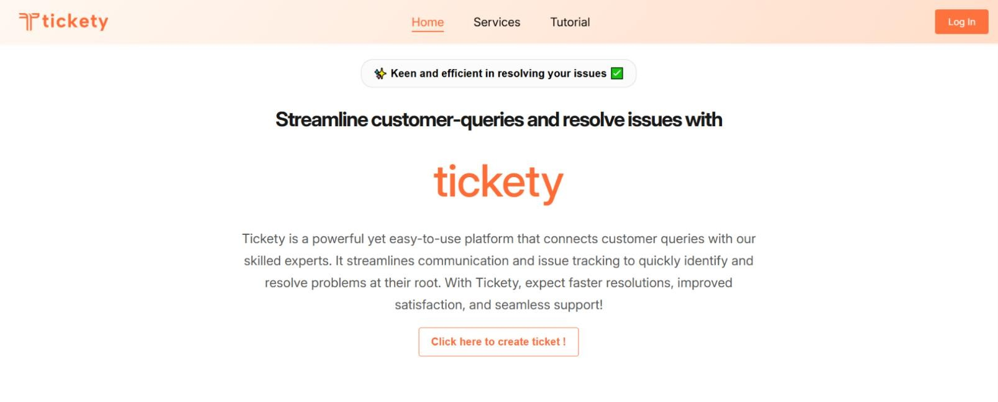
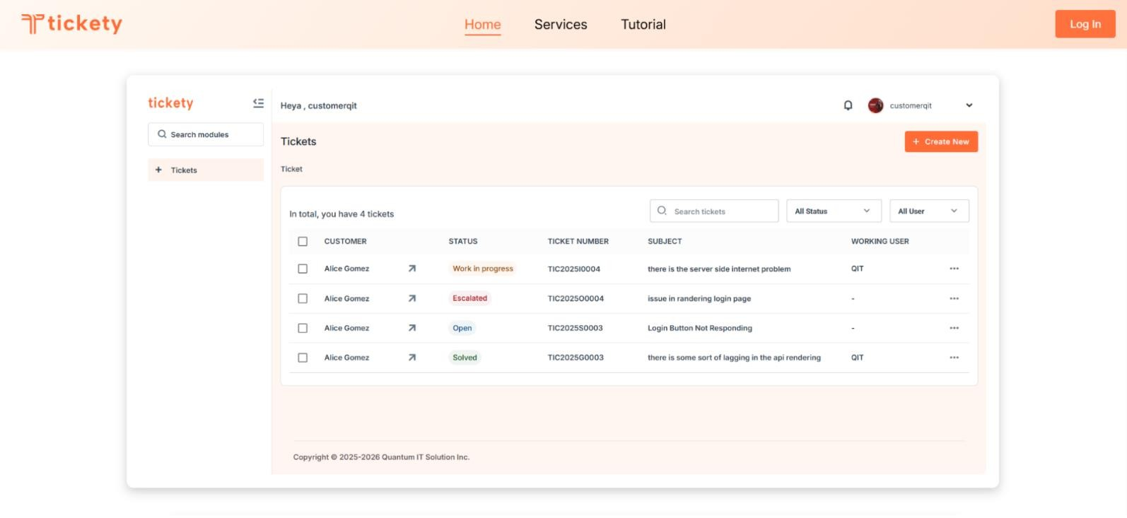
Software Support Ticketing System
9.2 Interface Design
The Software Support Ticketing System is designed to streamline the process of handling and tracking issues reported by customers of our software products.
Tickety’s Hero Page:
The Home Panel

Slide 48
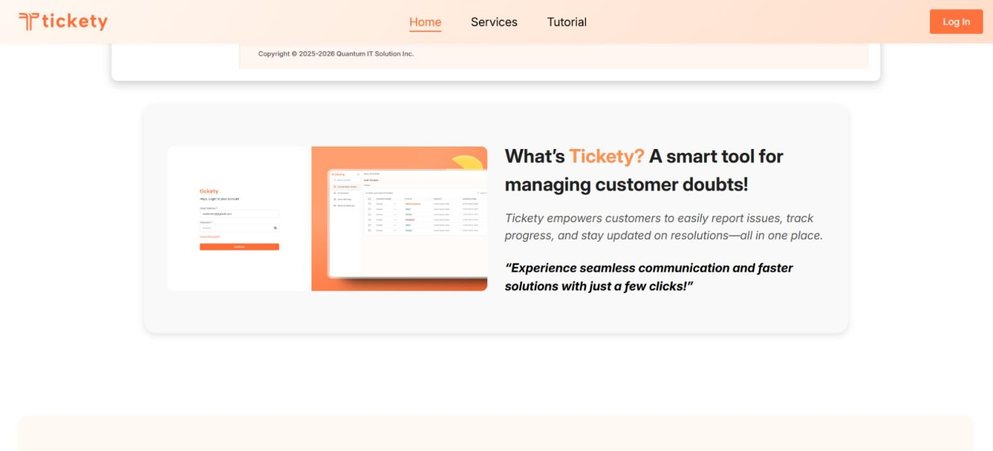
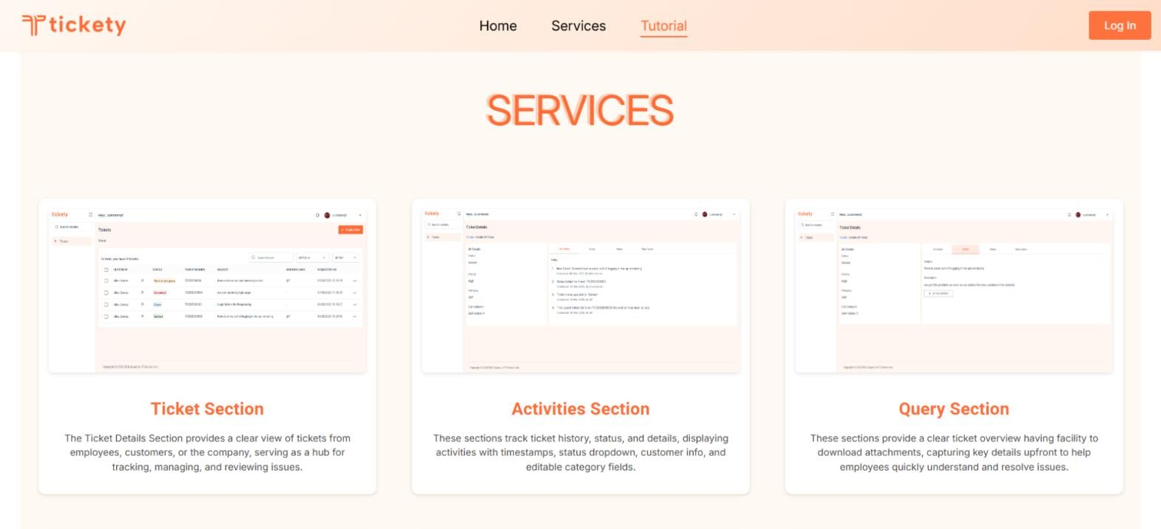
Software Support Ticketing System
Home Panel
Services Panel

Slide 49
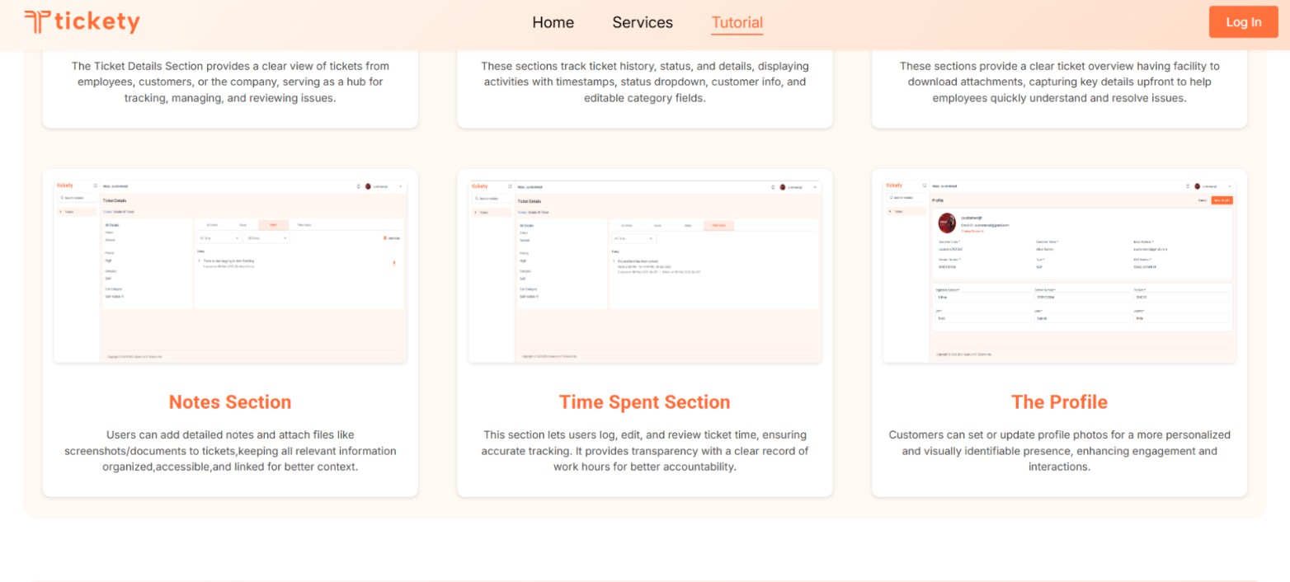
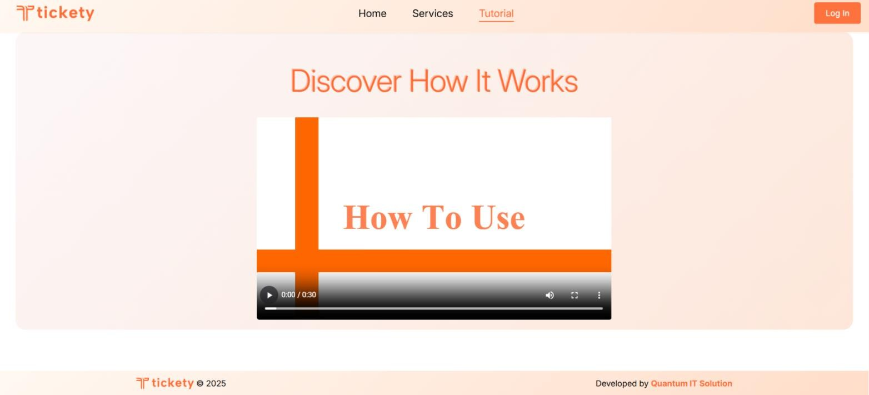
Software Support Ticketing System
Services Panel:
Tutorial Panel:

Slide 50

Software Support Ticketing System
Company’s Workflow
What is ticket?
In this system, a "ticket" serves as a record for any technical problem, question, or request raised by a client. Tickets allow both customers and company representatives to effectively report, manage, and resolve software-related issues.
When a customer encounters an issue, they can create a ticket specifying the subject and description of the problem. Alternatively, if the customer reports the issue verbally, a developer or any authorized company representative can create the ticket on their behalf. Each ticket includes fields to capture details such as the status, priority, category, and subcategory of the issue, ensuring that all necessary information is documented for efficient resolution. Additionally, the system tracks the person currently assigned to each ticket, the time spent on its resolution, and its priority level, giving all users clear visibility into the progress of each issue.
The system provides two separate workflows: one for internal company use and one for customer use.
Let’s Elaborate the Company Flow First:~
Company Workflow: When logged in, company admin have access to multiple modules and can:
Add and manage tickets for customers
Manage customer accounts, including creating accounts and providing login
credentials (email and password) to customers, bypassing the need for a separate registration process
Access user settings, system settings, and analyzing support logs
View the assignment and progress of each ticket, including the time spent and resolution priority.
50 | P a g e

Slide 51
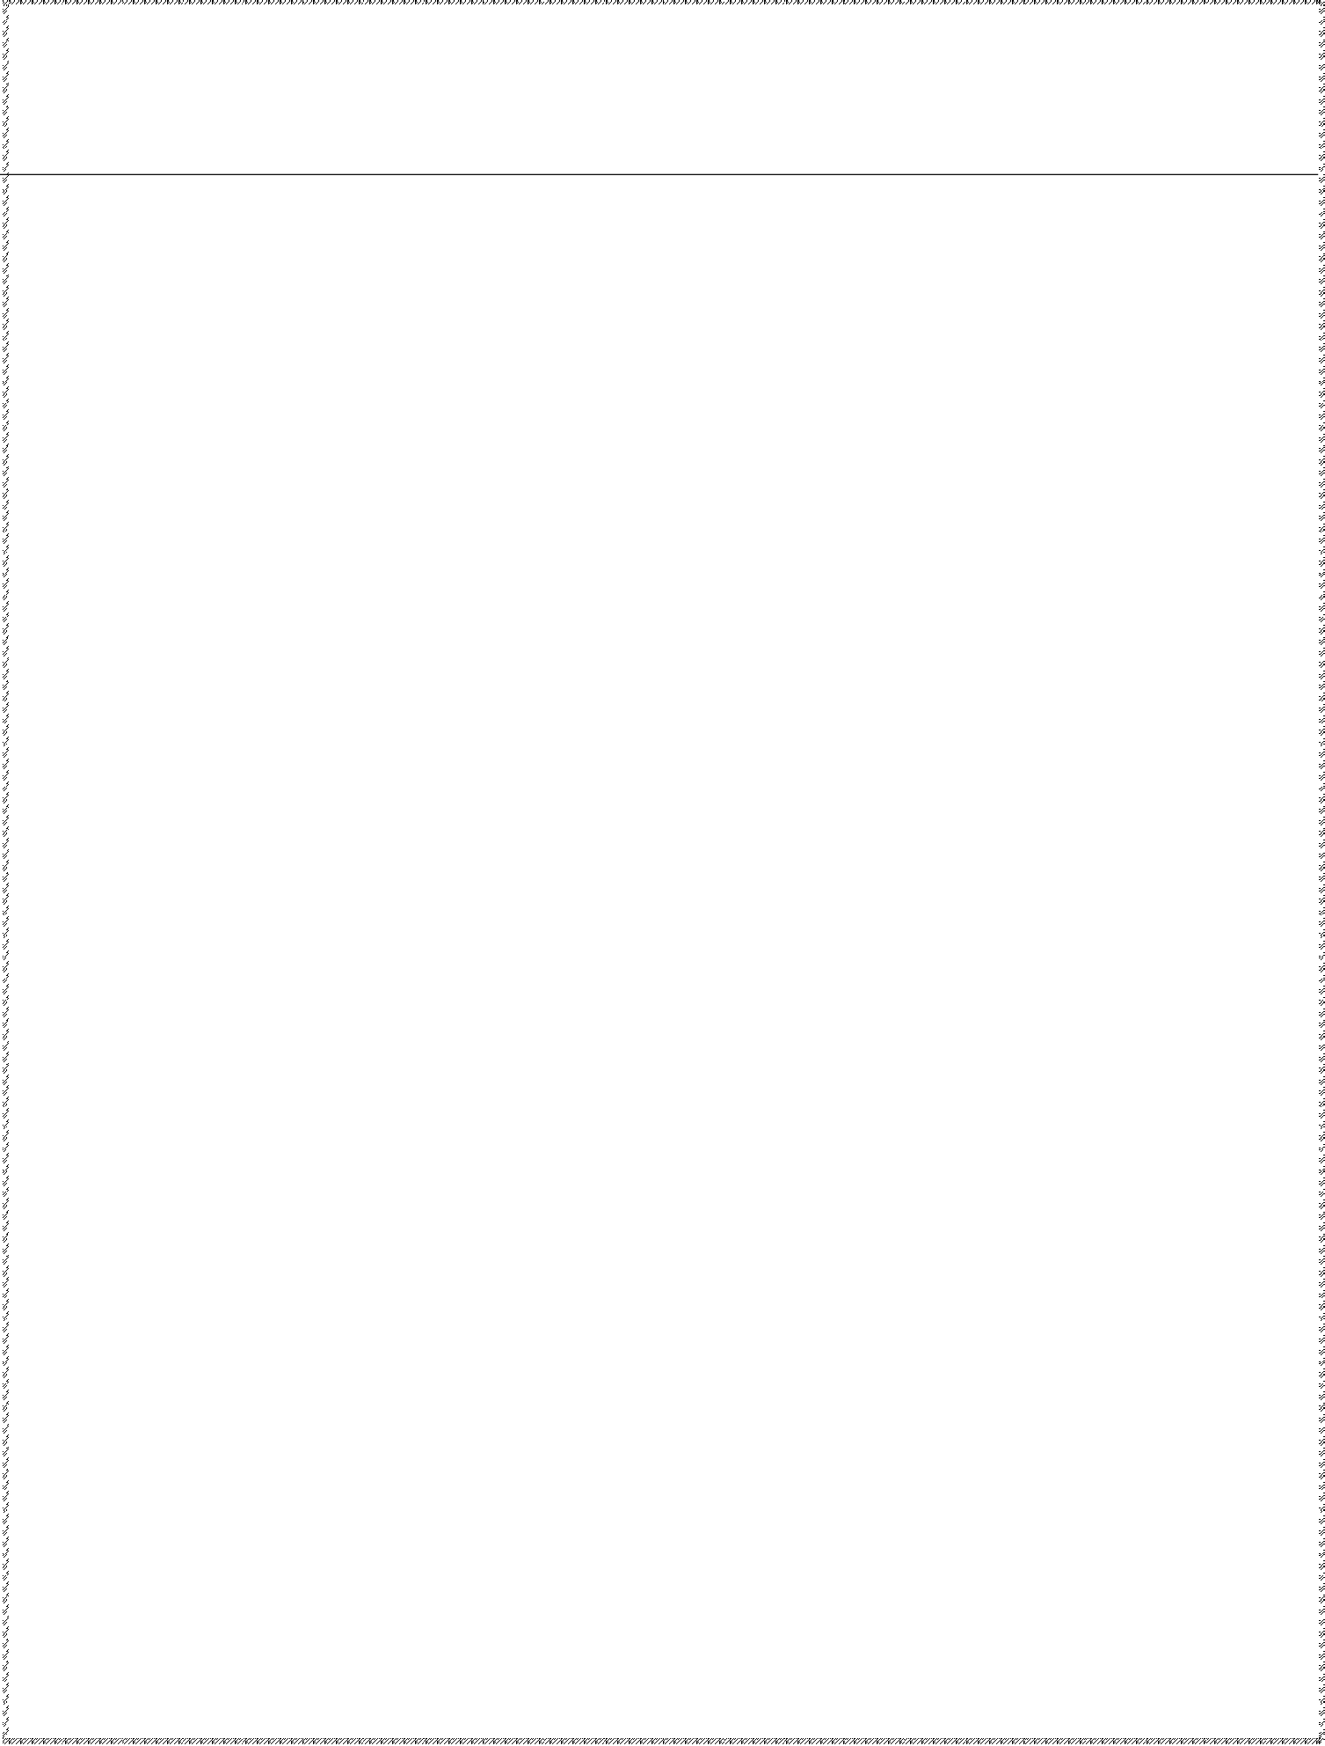
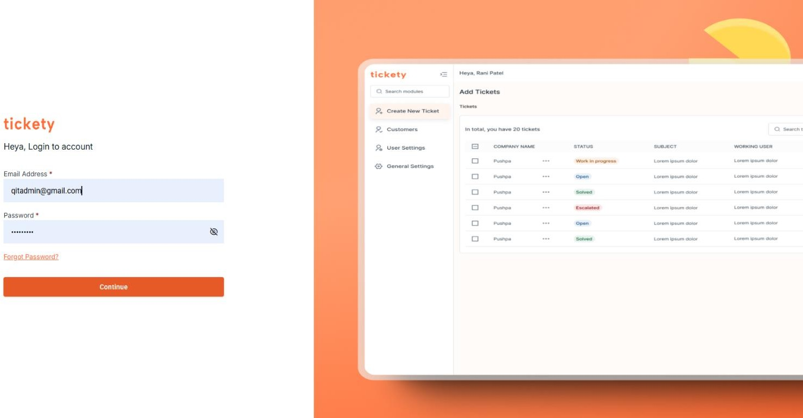
Software Support Ticketing System
Login
The login page allows users and administrators to securely access the Software Support Ticketing System by entering their email address and password. It provides a user-friendly interface for credential entry, error handling, and additional features such as password recovery and role-based access control.
Email Address:
Users can enter their email address in this field.
Password:
Users can enter their password in this field
Forgot Password?
If you've forgotten your password, click the "Forgot Password" link. You will be redirected to the Reset Password page, where you can enter your email address to receive a one-time password (OTP) for verification. Once your email is verified, you can reset your password and regain access to your account.
Email Address:
Enter your email address in this field to receive the OTP.

Slide 52
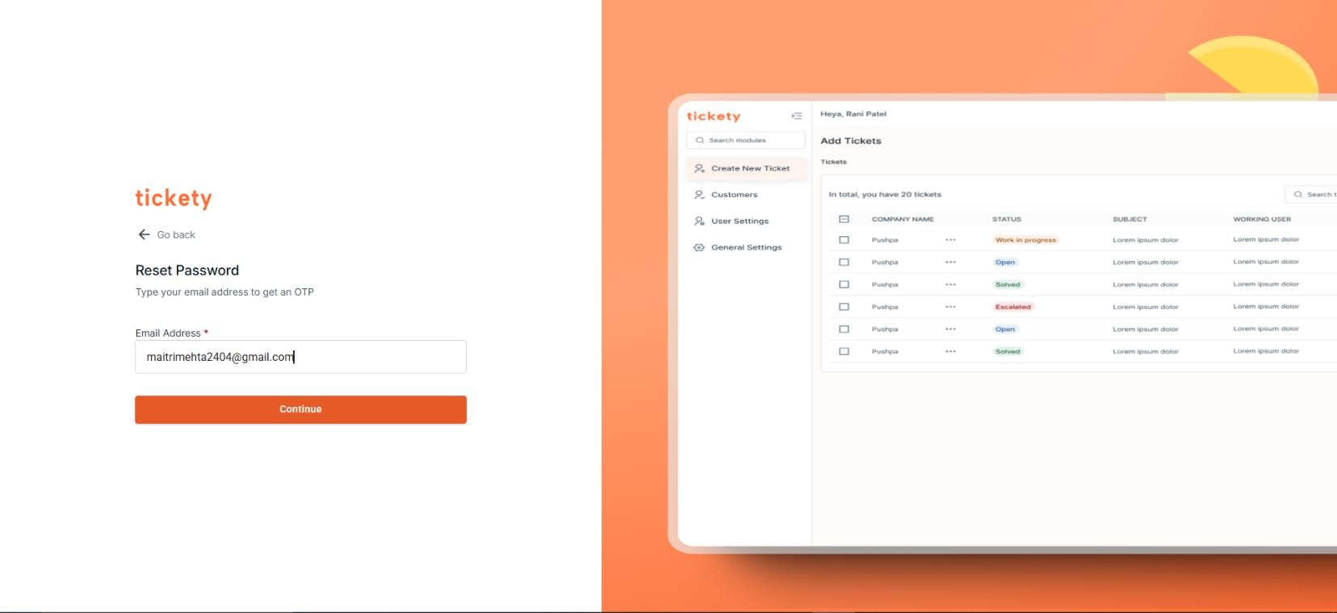
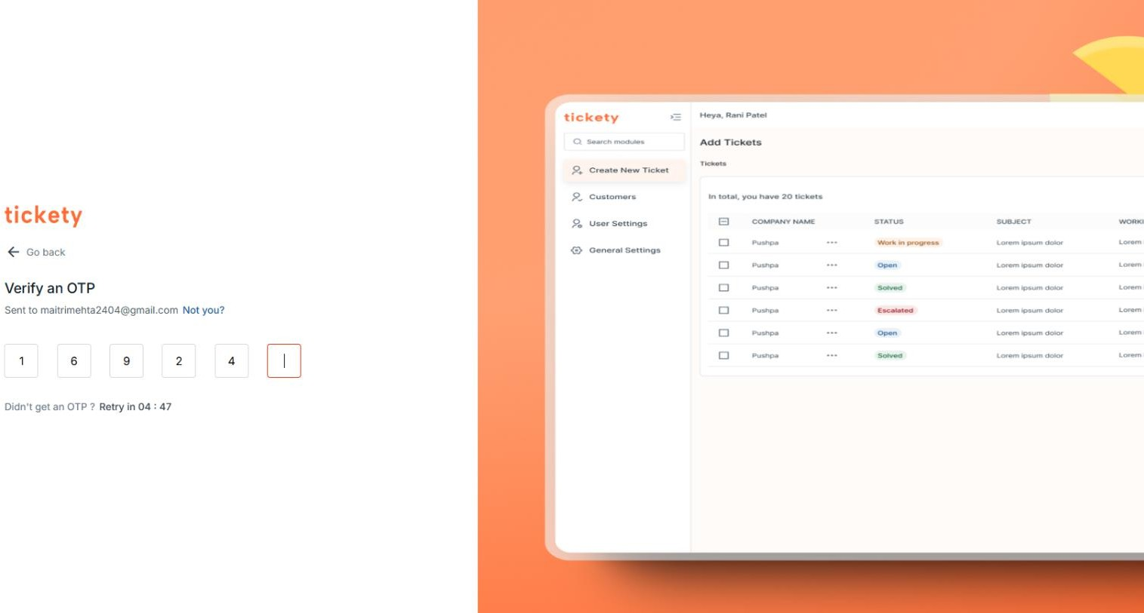
Software Support Ticketing System
OTP Successfully Verified Your One-Time Password (OTP) has been verified! You can now proceed to reset your password and securely access your account.

Slide 53
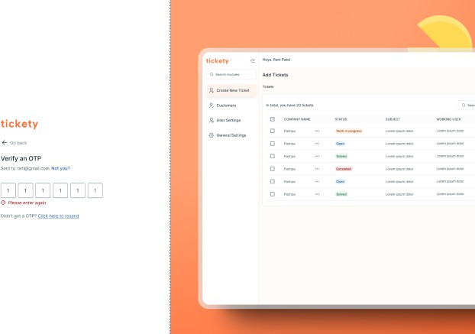
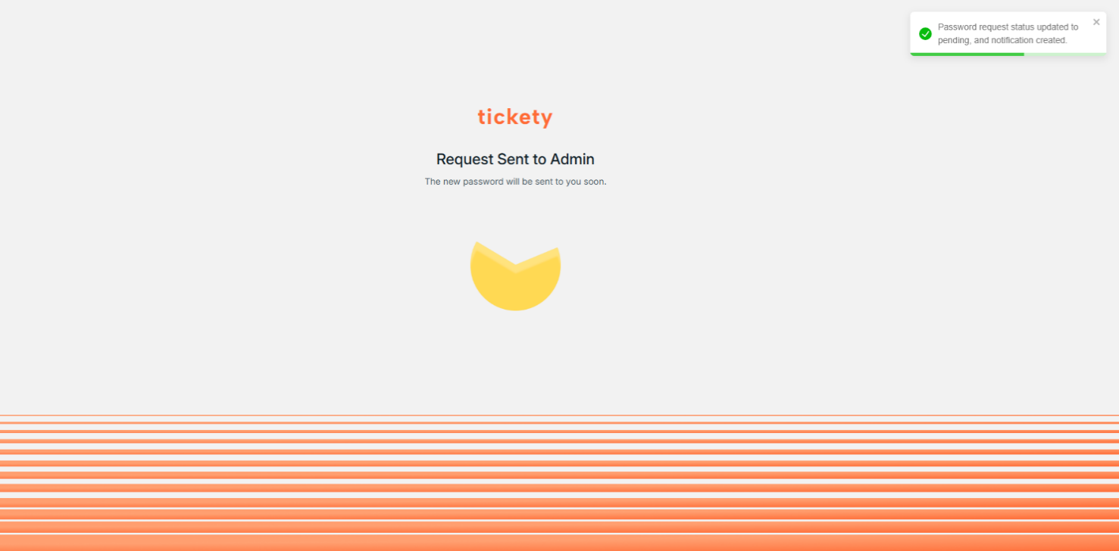
Software Support Ticketing System
Incorrect OTP: The OTP you entered is incorrect. Please check and try again. Ensure you’re entering the exact code sent to your email. If you’re experiencing issues or didn’t receive the OTP, click "Resend" to receive a new code. You can try again after the timer resets. Make sure to check your spam or junk folders as well.
Now the new password will be set up.

Slide 54

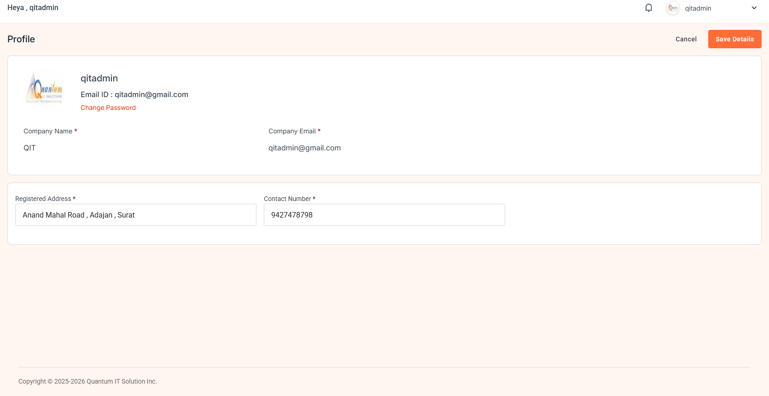
Software Support Ticketing System
Profile Section:
This section enables users to quickly access their own account details.
Profile Photo:
The user has the option to set or update their profile photo. This helps personalize the profile and allows the user to upload a photo that represents them visually within the system.
User Information Display:
This section provides details about the currently logged-in user, allowing them to view their personal and contact information at a glance.
Key details displayed include:
User Code: A unique identifier assigned to the user.
Username: The display name of the user within the system.
Email Address: The user’s registered email address for communication and notifications.
Contact Number: The user’s phone number for direct contact.
The user can also change that password

Slide 55
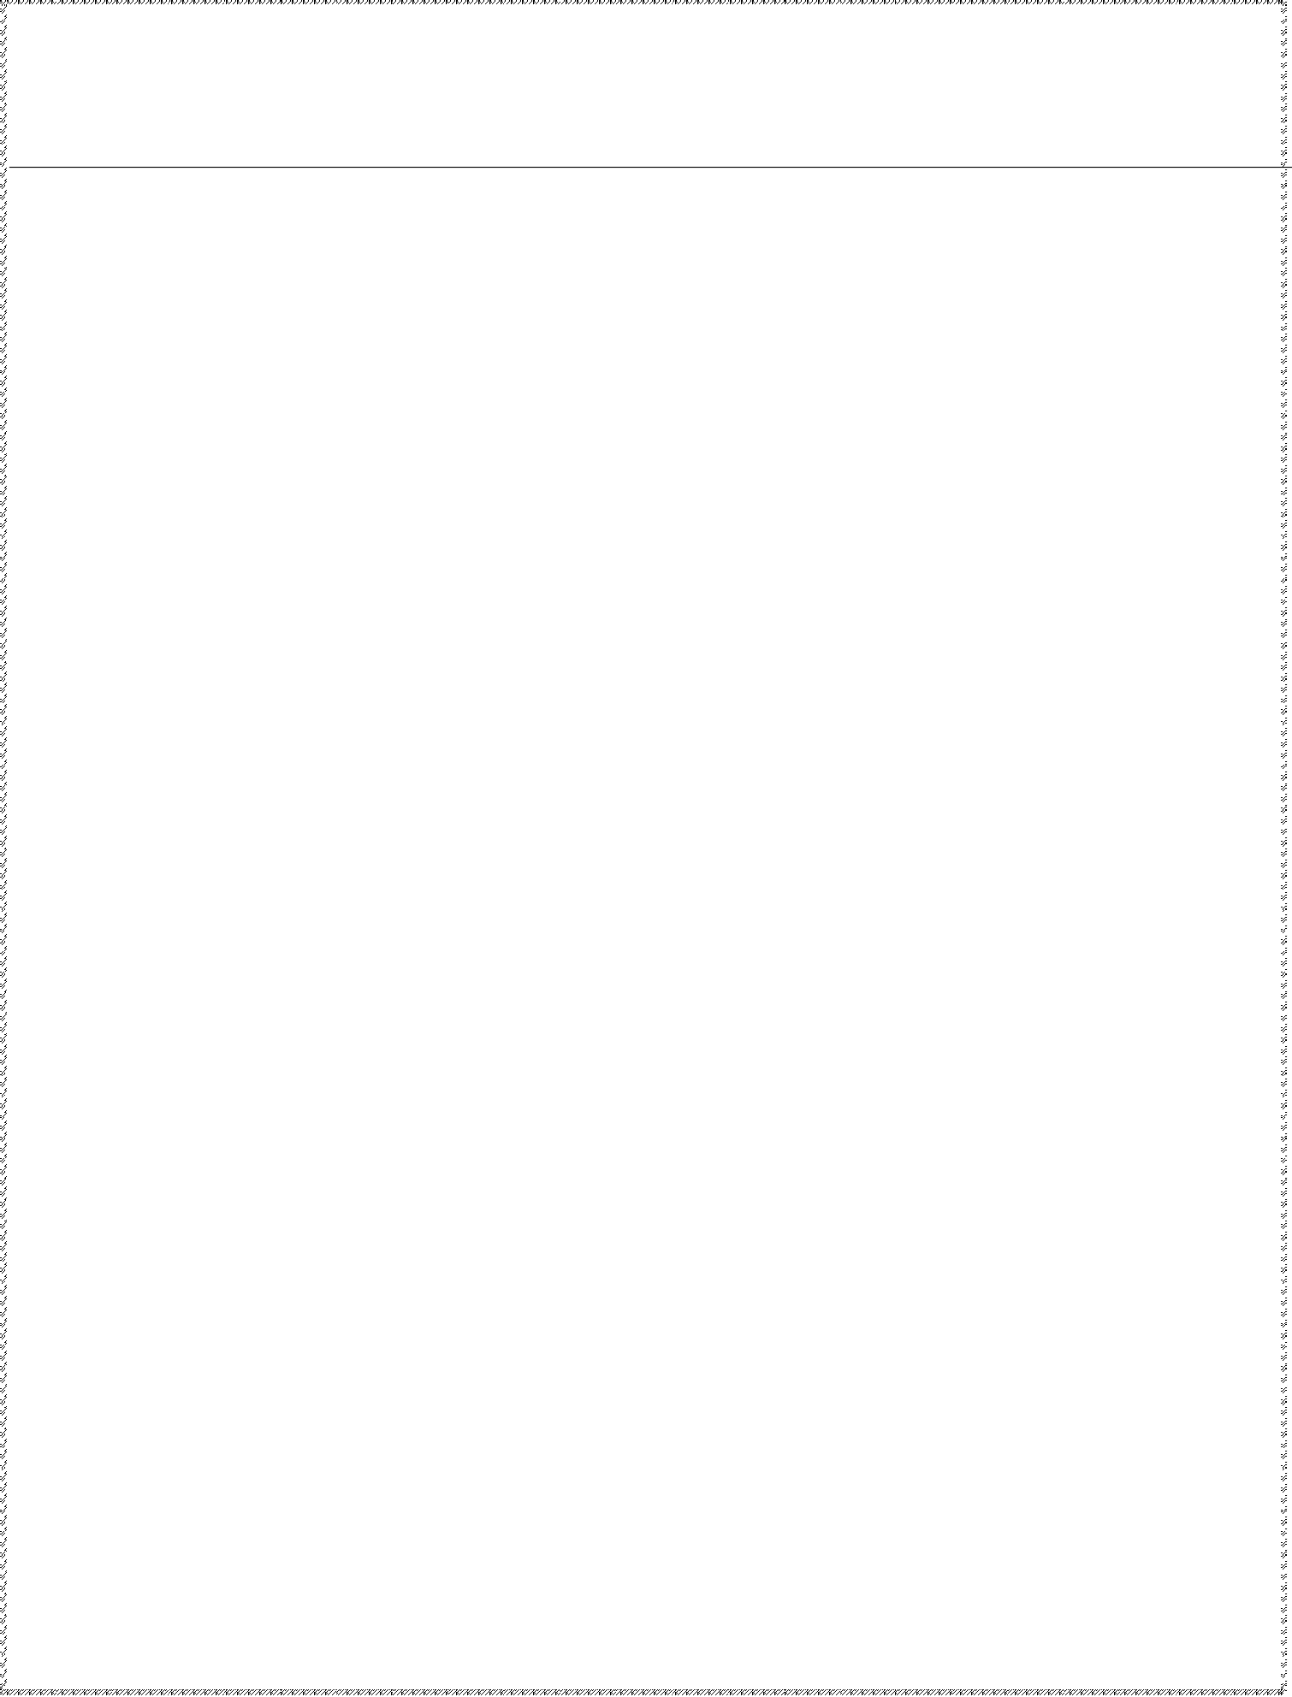
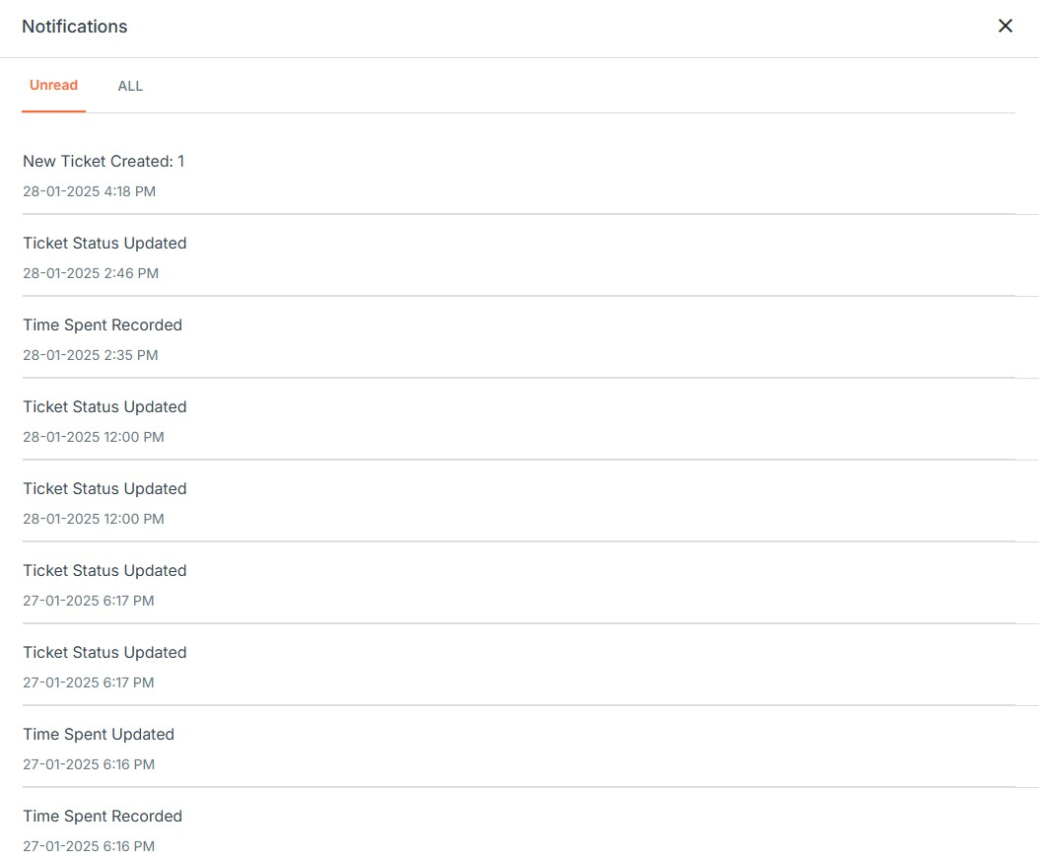
Software Support Ticketing System
Notification Section:
This flexible structure ensures that users receive clear, actionable information tailored to various types of notifications, whether they relate to meetings, requests, updates, change password request or other activities.
Notification Categories:
The section is divided into two categories:
Unread: Displays only the notifications that the user hasn’t opened yet, helping users quickly find new updates.
All: Shows the complete list of notifications, including both read and unread items, for a comprehensive view.
Notification Details: Each notification provides specific details relevant to the user's activities or interactions like:
Who initiated the action or request?
Relevant Parties involved in the notification.
Additional Information like time, date, or any other pertinent details specific to the action.

Slide 56
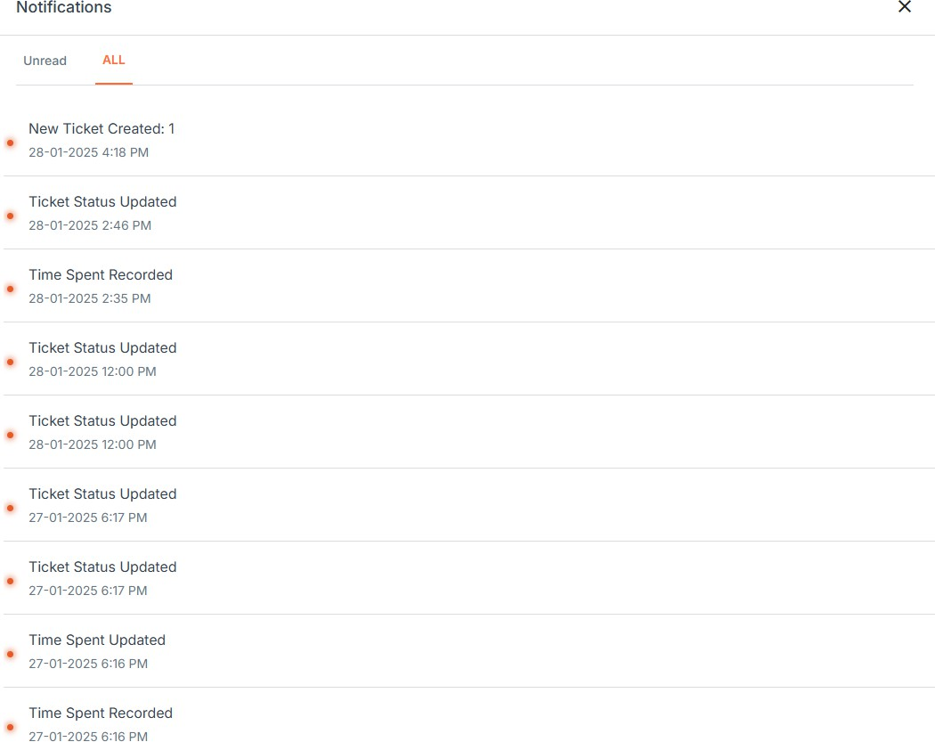
Software Support Ticketing System

Slide 57

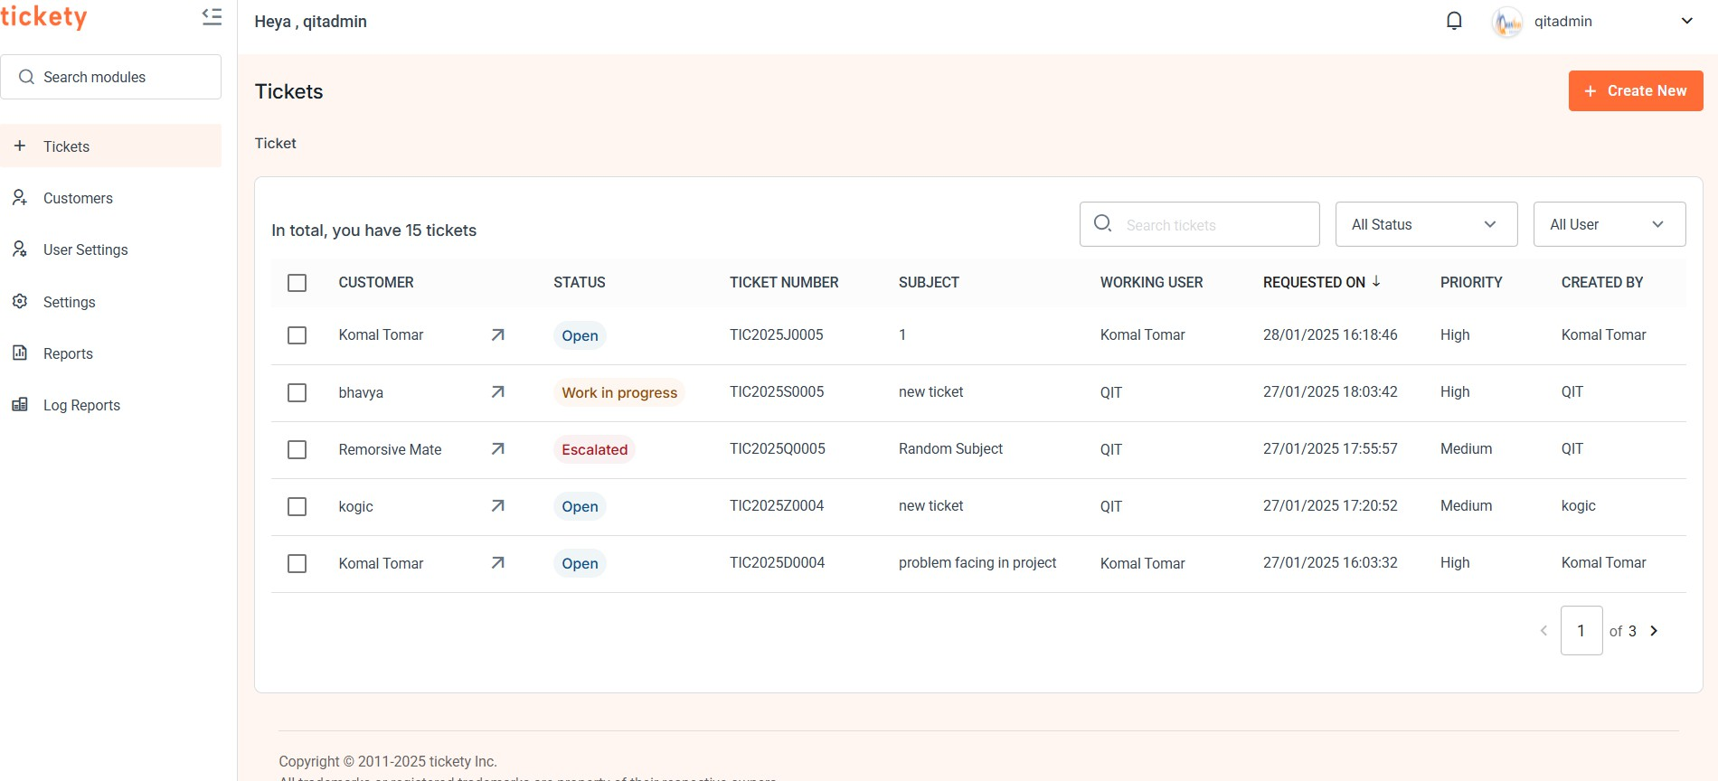
Software Support Ticketing System
Ticket Section:
Here's a structured breakdown of the ticket list information shown in the image:
Customer Name
Displays the name of the customer, shown as a clickable link.
Clicking the name reveals additional actions related to the customer.
When the user clicks on the arrow next to a ticket, a detailed section expands, displaying
additional information about the ticket. This view provides a more comprehensive look at the ticket's specifics, helping users understand and manage the ticket more effectively.
Status
Indicates the current status of each ticket.
Status options include:
Open
Work in Progress
Escalated
Solved

Slide 58

Software Support Ticketing System
Ticket Number
Auto-generated unique identifier for each ticket.
Subject
Brief description or topic of the ticket.
Working User
Indicates the user assigned to work on the ticket.
Requested On
Shows the date and time when the ticket was requested.
Examples include:
Yesterday at a specific time
Today at a specific time
Priority
Specifies the urgency level of the ticket.
Priority levels include:
High
Medium
Low
Created by
Shows who has generated the ticket
Clicking on the button allows the user to initiate the process of creating a new ticket. This feature opens a form or interface where users can:~

Slide 59
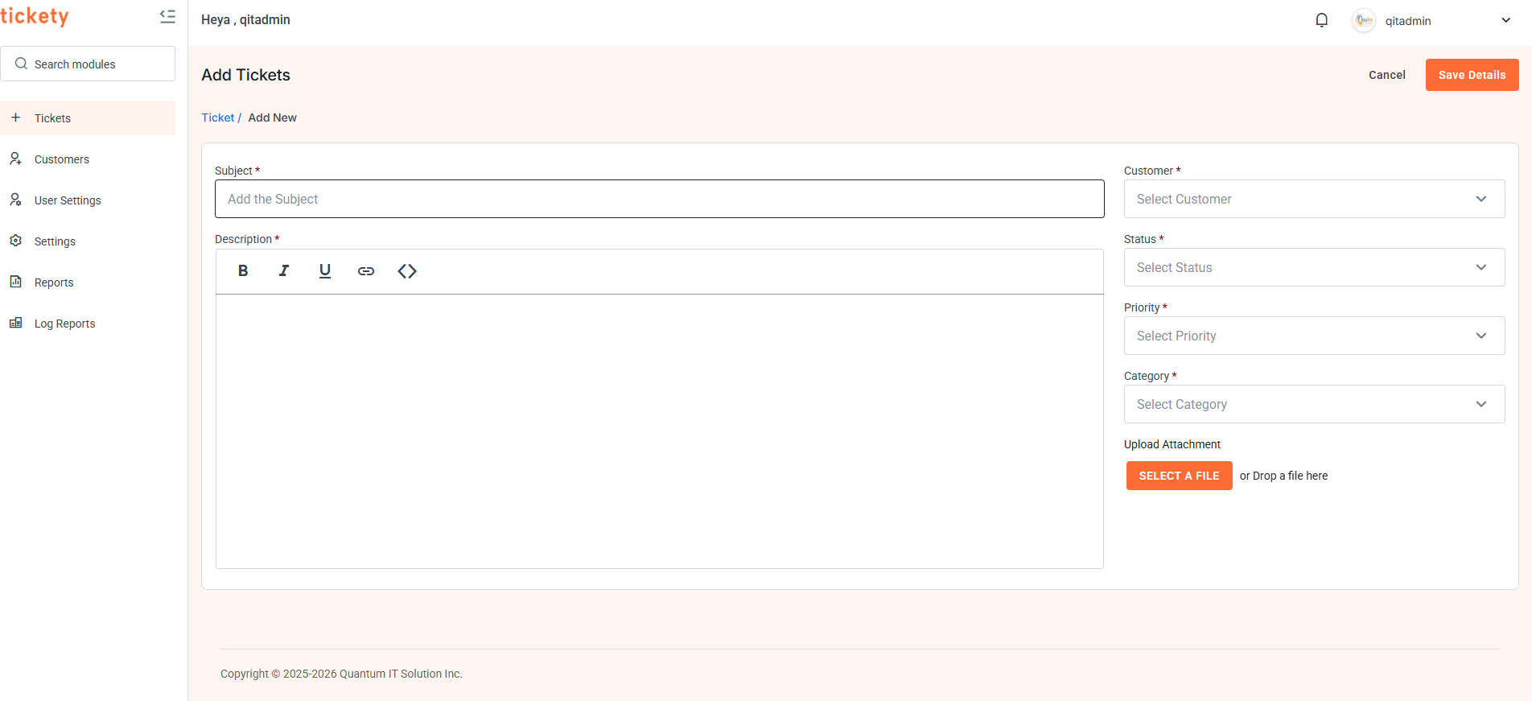
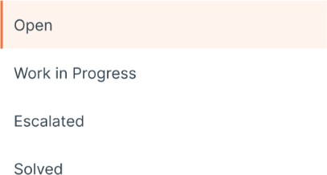
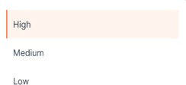
Software Support Ticketing System
In the new ticket creation process, the user has the following options:
Subject: Enter a brief title for the ticket.
Description: Provide a detailed explanation of the issue or request.
Customer Name: Select the customer associated with the ticket.
Status: Choose the initial ticket status from:
Priority: A dropdown to select the priority level. Options could be:

Slide 60
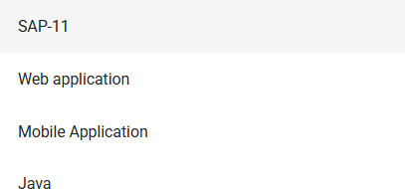

Software Support Ticketing System
Category: Specify the general category of the ticket and the categories are fetched by API call, such as:
Subcategory: Select or create a new specific subcategory within the chosen category, and the sub-categories are fetched by API call such as:
As soon as category will be selected their specialized sub-category dropdown will appear.
Upload Attachment: If there are any attachment regarding ticket, we can attach it during ticket formation.
Save Details:
This ensures that any updates or changes to the information are securely stored and maintained within the system, safeguarding the integrity and privacy of the data.
60 | P a g e

Slide 61

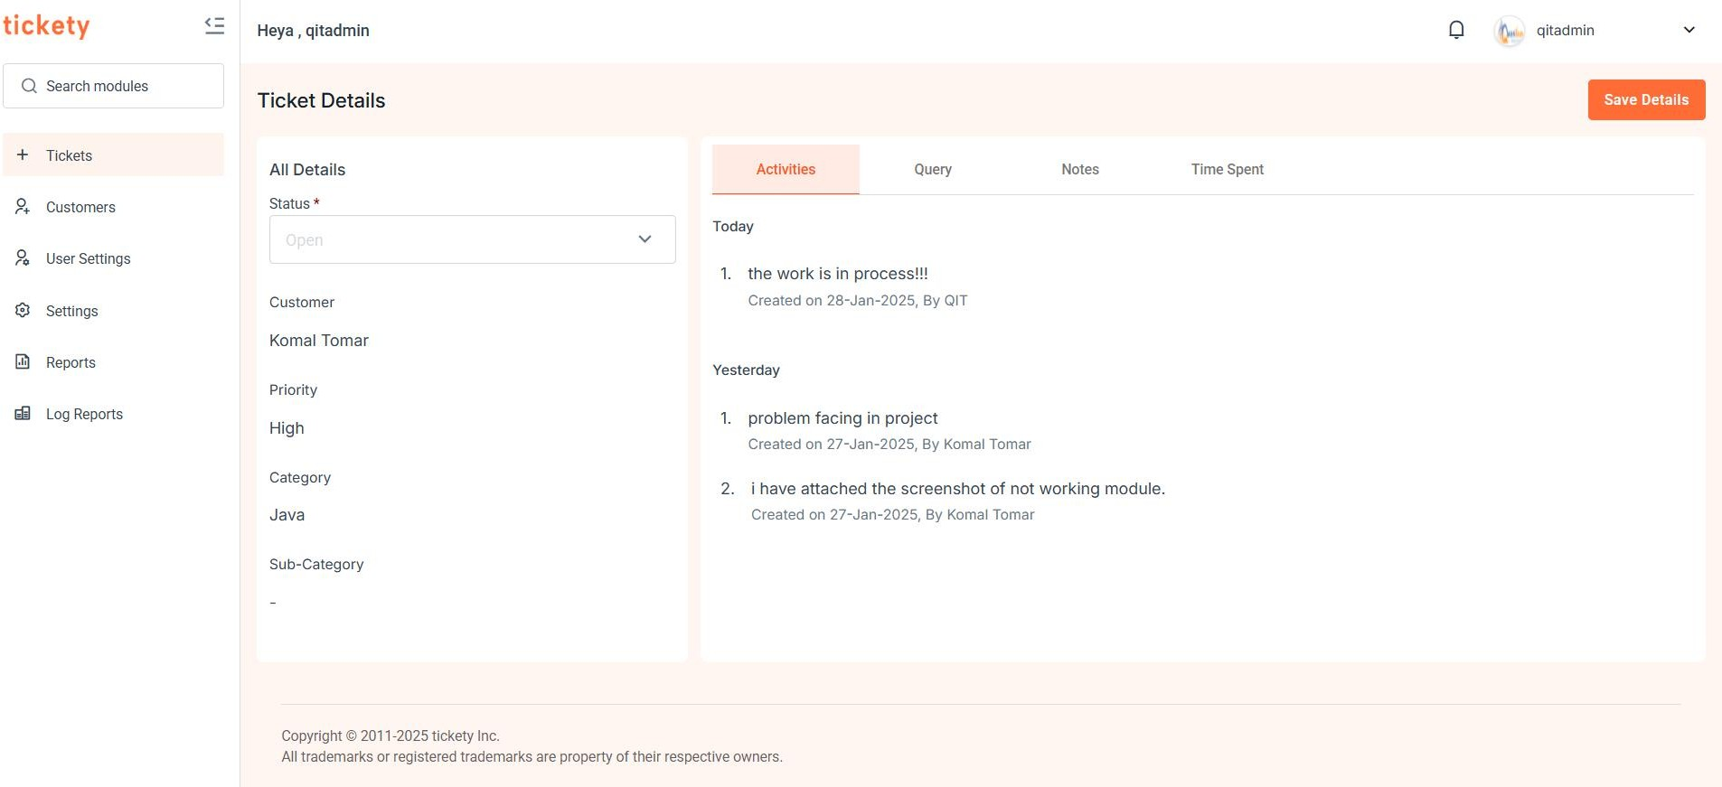
Software Support Ticketing System
Details of Ticket:
Activity Tab:
These sections help track the history, status, and details of each ticket, improving clarity and ease of management for users working on the support or service team.
Displays all the activities performed on a specific ticket with timestamps.
The "Status" drop down allows selecting the current status of the ticket.
Shows the customer associated with the ticket.
Includes fields for ticket "Category," and "Sub-category," which can be set or modified by the user when creating or updating a ticket.

Slide 62
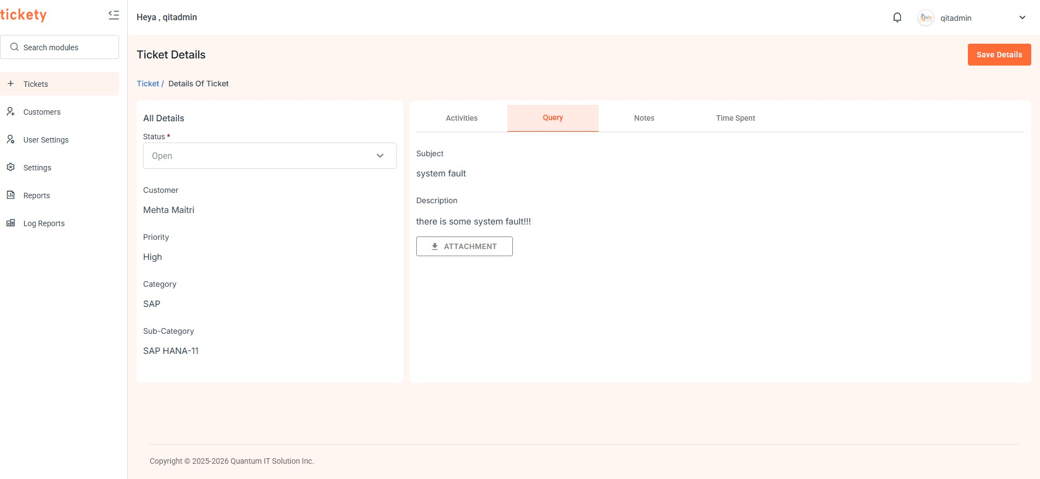
Software Support Ticketing System
Query Tab:
These sections help track the history, status, and details of each ticket, improving clarity and ease of management for users working on the support or service team.
Displays the "Subject" and "Description" for the ticket.
These fields are likely defined when the ticket is initially created.
⇩ Attachment: Used to download the attachment which is being uploaded during ticket creation.
Save Details:
This ensures that any updates or changes to the information are securely stored and maintained within the system, safeguarding the integrity and privacy of the data.

Slide 63
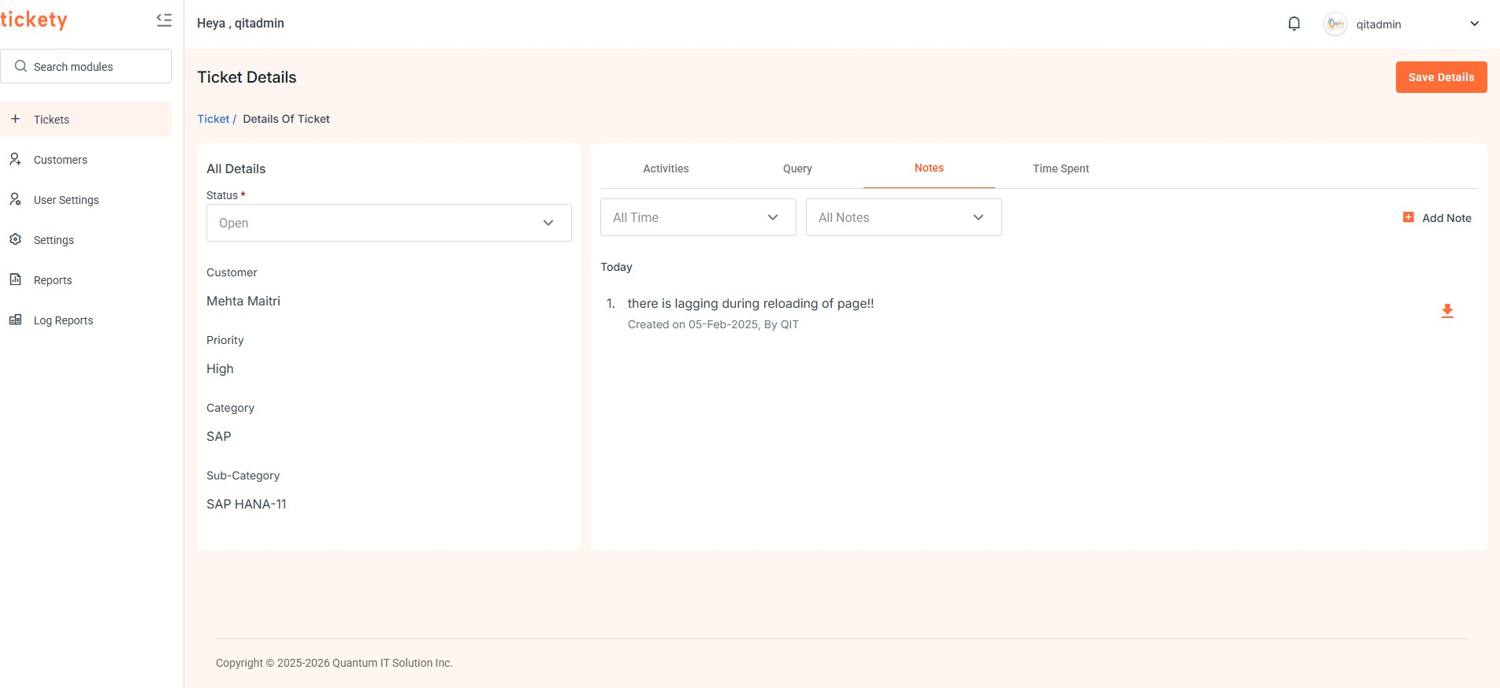
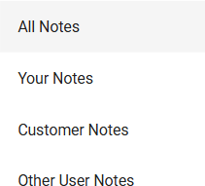
Software Support Ticketing System
Note Tab:
This section provides users with the ability to document ticket-related information
comprehensively, including text descriptions and file attachments, enhancing collaboration and record-keeping.
View Notes by Time and Type:
The user can view all notes related to a ticket, organised by time and type.
Note Type Filter: Users can choose to view specific types of notes, such as "Your Notes," "Customer Notes," and "Other User Notes."

Slide 64
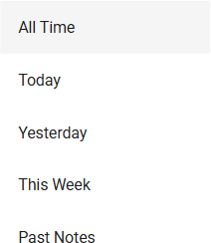
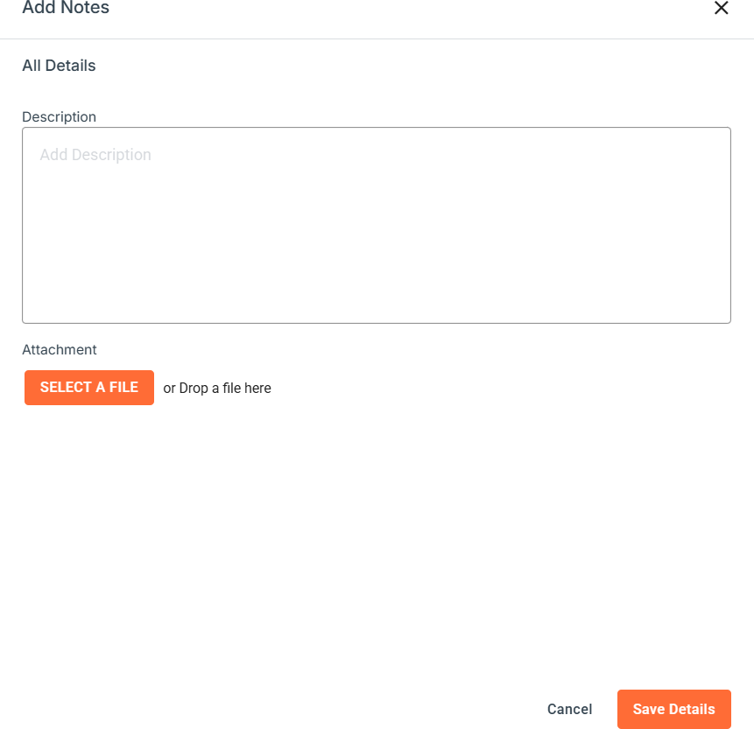
Software Support Ticketing System
Time Filter: Options to filter notes by time periods such as "Today," "Yesterday," "This Week," "Past Notes” allow users to focus on recent or relevant updates.
Add Note:

Slide 65
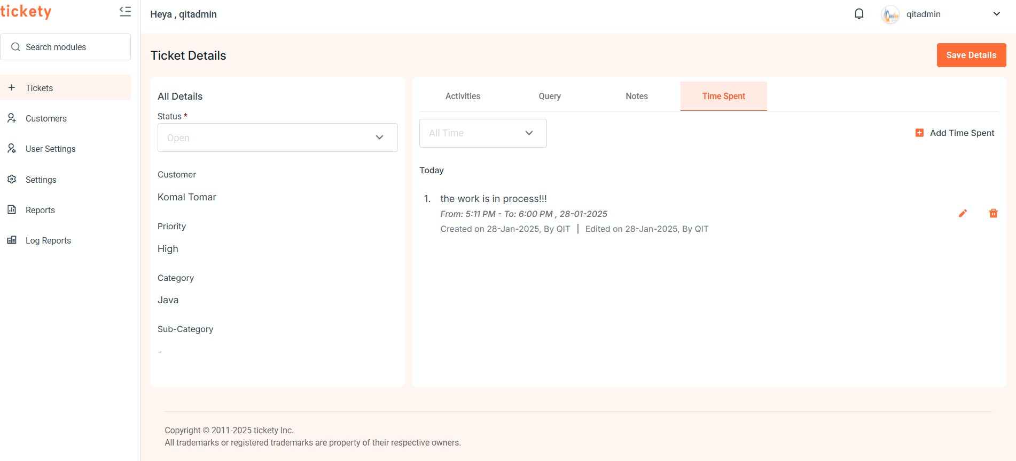
Software Support Ticketing System
When the user clicks on the "Add Note" button, a field appears that allows them to add a description related to the ticket.
Additionally, users can upload files related to the note, such as screenshots, documents, or other relevant attachments, which are then linked to the note.
Time Spent Tab:
This section enables efficient tracking and management of work time, allowing users to
accurately log, edit, and review time spent on a ticket, ensuring accountability and clarity in the work performed.
View Work Logs:
Displays a detailed log of time spent on the ticket, including:
Who performed the work?
Duration of work (in hours).
Start and End Times of each work session.
Date information (e.g., "Today," "Yesterday") for quick reference.
Each entry includes an Edit and Delete option, allowing users to update or remove time logs as needed.

Slide 66
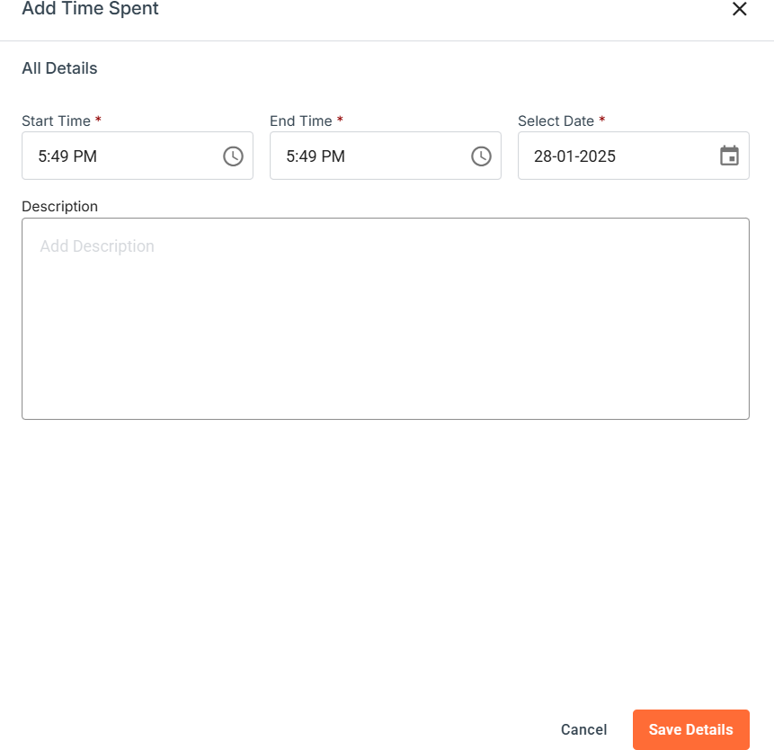
Software Support Ticketing System
Save Details: This ensures that any updates or changes to the information are securely stored and maintained within the system, safeguarding the
integrity and privacy of the data.
Add Time Spent:
By clicking on the "Add Time Spent" button, a form opens where users can enter specific details:
Start Time and End Time for the work session.
Description of the work performed, providing context and details about the tasks completed.
Save Details: This ensures that any updates or changes to the information are securely stored and maintained within the system, safeguarding the
integrity and privacy of the data.

Slide 67
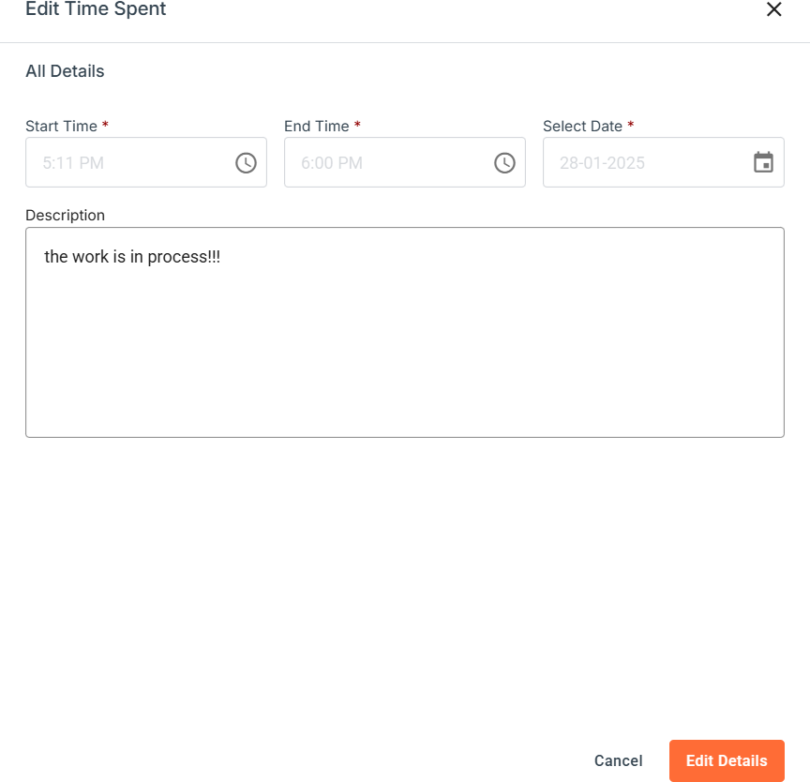
Software Support Ticketing System
Edit Option:
If a user wants to edit an existing time entry, they can click the Edit button next to that entry.
This action opens a form allowing the user to modify details such as Start Time, End Time, and Description of the work performed.
Once changes are made, the updated information is saved, providing accurate tracking of time and tasks.
Edit Details: This ensures that any updates or changes to the information are securely stored and maintained within the system, safeguarding the integrity and privacy of the data.

Slide 68
Software Support Ticketing System
Delete Option:
If a user needs to delete time entry, they can click the Delete button next to it.
This action permanently removes the selected time log from the record, helping to keep the time log accurate and relevant by eliminating unnecessary or incorrect entries.

Slide 69
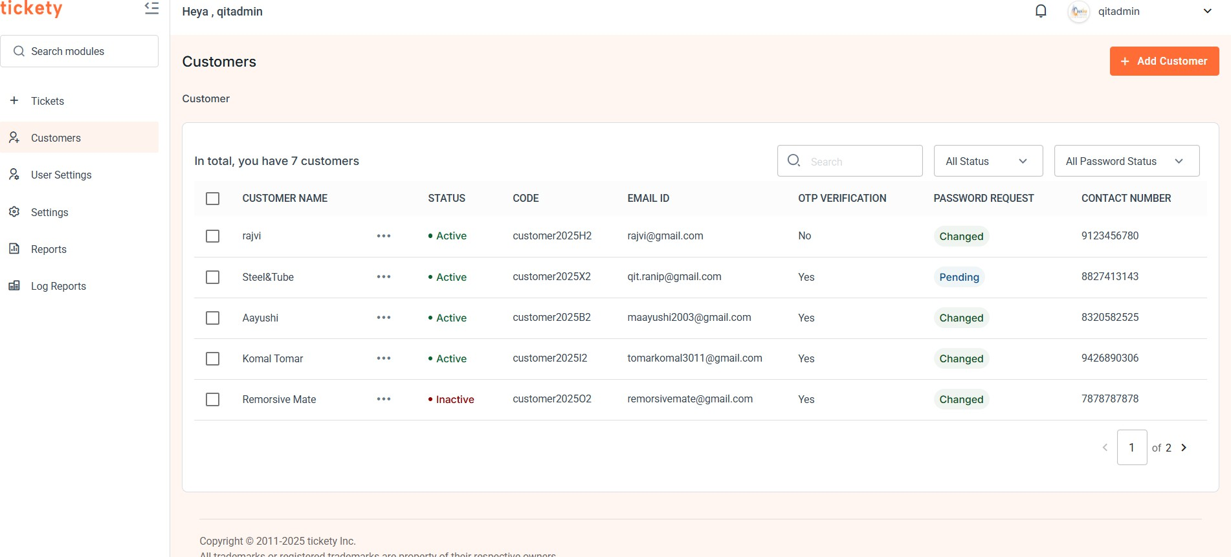
Software Support Ticketing System
Customer And New Customer Section:
The Customers page allows users to manage customer records efficiently. Here, company
representatives can view a list of all customers, check the status of their accounts, verify OTP (One-Time Password) status, and manage password change requests.
Customer List: This table displays a summary of customer information, including:
Customer Name: The name of the customer, displayed as a clickable link. Clicking on a customer name reveals additional actions.
Status: Indicates whether a customer is Active or Inactive.
OTP Verification impacts the customer’s status:
If OTP verification is successful, the status will automatically update to
Yes.
If OTP verification fails, the status remains No and cannot be manually changed.
Customer Code: A unique identifier for each customer.
Email ID: The customer's email address.
OTP Verification: Displays Yes if the OTP was correctly entered, or No if it was not.
Password Request: Shows the status of any password change requests:

Slide 70
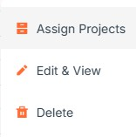

Software Support Ticketing System
Pending: The request is awaiting approval from the company.
Changed: The request has been approved, and the password has been updated.
Contact Number: Displays the contact number of the customer.
Search and Filters:
Search: Allows users to search for specific customers by entering their name.
Status Filter: Filters the customer list based on their Active or Inactive
status.
Password Request Filter: Filters customers by the status of their password request (e.g., Pending, Changed).
Three-Dot Menu (Dropdown Actions):~
Each customer row has a three-dot menu to the right. Clicking on this menu opens a dropdown with the following options:
Edit & View: Redirects the user to the "Edit Customer" page, where they can update customer information.
Delete: Allows users to delete the selected customer from the list.
Assign Projects: Used to assign projects to customer.
Add Customer Button: Located at the top right corner, this button lets users add a new customer. Clicking this button opens a form for entering customer details.
70 | P a g e

Slide 71
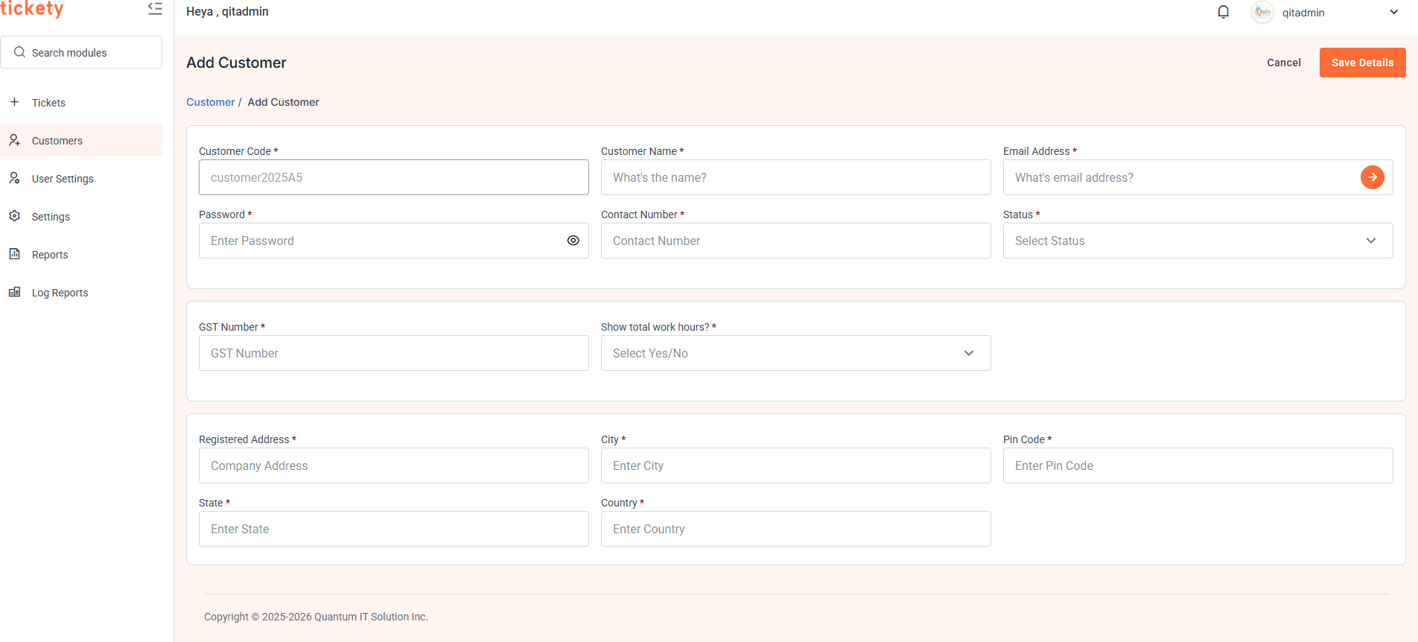
Software Support Ticketing System
To generate a new customer, the following fields are required in the "Add Customer" form. Each field has specific validation and behavior to ensure correct data entry and workflow.
Add Customer Form Fields
Customer Code:
Type: Unique identifier.
Description: This field serves as a unique identifier for each customer.
Customer Name:
Type: Text input.
Description: The name of the customer.
Email Address:
Type: Email input with OTP verification.
Description: The customer's email address.

Slide 72
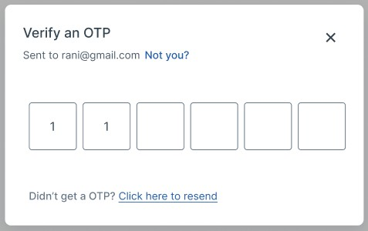
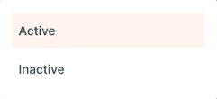
Software Support Ticketing System
Verification: An arrow icon next to this field triggers an OTP verification popup when clicked.
OTP Verification: If the OTP sent to the email is verified, the Status field automatically updates to "Active". If the OTP is not verified, the status remains "Inactive" and cannot be changed manually.
Password:
Type: Password input.
Description: Password for the customer's account. This password will be provided to the customer for login purposes.
Contact Number:
Type: Number input.
Description: The customer's contact phone number.
Status:
Type: Dropdown (Active / Inactive).
Behavior: Automatically set to "Active" if the OTP is verified. If the OTP is not verified, the status remains "Inactive" and cannot be manually changed to "Active."

Slide 73
Software Support Ticketing System
GST Number:
Type: Text input.
Description: GST (Goods and Services Tax) number of the customer, if applicable.
Registered Address:
Type: Text input.
Description: The official address registered for the customer.
City:
Type: Text input.
Description: City where the customer is located.
Pin code:
Type: Number input.
Description: Postal code for the customer's location.
State:
Type: Text input.
Description: State or province of the customer's registered address.
Country:
Type: Text input or dropdown.
Description: Country where the customer is located.
Save Details Button:
Purpose: To save the current customer's information and view their full details.
Behavior: When clicked, this button saves the customer’s information and redirects the user to the Customer Detail Page. This page provides an overview of the customer’s profile,
including all saved details, and allows for further actions or edits if needed.

Slide 74

Software Support Ticketing System
EDIT CUSTOMER:
In the Edit Customer page, all fields are pre-filled with the current details of the selected customer, allowing for easy updates and modifications. Here’s a breakdown of how this page functions:
Pre-filled Fields:
When a user navigates to the Edit Customer page, all fields—such as Customer Code, Customer Name, Email Address, Contact Number, Status, Customer Type, GST Number, Registered
Address, City, Pin code, State, and Country—are automatically populated with the existing information.
This helps the user to quickly review and modify any specific details without having to re-enter everything.
Email Address Change and OTP Verification:
If the Email Address field is modified, an OTP verification process is triggered again to confirm the new email address.
Upon changing the email, an OTP will be sent to the new address. Only after successful OTP entry can the email change be confirmed.
If the user does not change the email, the OTP status remains unchanged, and no additional verification is required.

Slide 75

Software Support Ticketing System
Assign Projects
Here, the projects are assigned to the customers.

Slide 76

Software Support Ticketing System
User Settings Section:
In the User Settings section, the admin has the ability to manage employee and developer
credentials. This includes creating, editing, and viewing user accounts, enabling seamless control over access to the system.
User List View
The user list is displayed in a table format and includes the following columns:
Username: The unique identifier of the user, displayed as a clickable link. Clicking on the username reveals additional user details and actions.
Status: Indicates whether a user is Active or Inactive.
Active: The user is currently active and has access to the system.
Inactive: The user is restricted from accessing the system.
User Code: A unique identifier assigned to each user for easy tracking and reference.
Email ID: The email address associated with the user account.
Contact Number: Displays the contact number of the user.
Password Request Status: Shows the status of any pending password requests for the user:

Slide 77


Software Support Ticketing System
Pending: The request is awaiting approval. Changed: The password has been updated. Search & Filter Functionality
Admins can quickly search for users by typing keywords in the search bar. Additionally, the list can be filtered based on:
Status: Filter users by their current status (Active or Inactive).
Password Requested: Filter users based on whether they have requested a password reset.
Three-Dot Menu (Dropdown Actions):
Each user row has a three-dot menu to the right. Clicking on this menu opens a dropdown with the following options:
Edit & View: Redirects the admin to the "Edit User" page, where they can update user information.
Delete: Allows admin to delete the selected user from the list.
Add User Button: Located in the top-right corner, this button enables the admin to create a new user. Clicking this button redirects the admin to the "Add User" page, where they can enter the new user's details, such as username, email, password, etc.

Slide 78

Software Support Ticketing System
Add User Form Fields:
User Code:
Type: Unique identifier.
Description: A unique identifier assigned to each user. This field must be filled with a unique value to prevent duplicates.
Username:
Type: Text input.
Description: The chosen username for the user. This will be used for login and identification purposes.
Email Address:
Type: Email input.
Description: The user's email address for account access and communication.
OTP Verification: An arrow icon next to this field triggers an OTP verification popup when clicked. This ensures that the provided email address is valid and not fake.
If the OTP is verified, the Status field automatically updates to "Active."

Slide 79


Software Support Ticketing System
If OTP verification fails, the status remains "Inactive," and the admin cannot manually set it to "Active."
Password: Type: Password input.
Description: The password for the user's account. This will be used for login purposes.
Contact Number:
Type: Number input.
Description: The user’s contact number for communication purposes.
Status:
Type: Dropdown (Active / Inactive).
Behavior: The status will automatically be set to "Active" if the OTP is successfully verified.
If OTP verification fails, the status will remain "Inactive," and the admin will not be able to change it to "Active" manually.
Top-Right Section Buttons:
Save Details Button:
Purpose: To save the current user's information and view the details.

Slide 80

Software Support Ticketing System
Behavior: When clicked, the current user’s details are saved, and the admin is redirected to the User Detail Page. This page displays a comprehensive view of the user’s profile, including all saved details and options for further actions or edits.
EDIT USER PAGE:
The Edit User page allows admins to update the details of an existing user. This page is pre-
filled with the current information of the selected user, making it easy for admins to review and modify specific fields.
Pre-filled Fields:
When navigating to the Edit User page, the following fields are automatically populated with the current details of the selected user:
User Code: The unique identifier assigned to the user.
Username: The user’s current username.
Email Address: The user’s email address.
Contact Number: The user’s current contact number.
Status: The current status of the user (Active / Inactive).
Password: The user’s existing password.
80 | P a g e

Slide 81
Software Support Ticketing System
These pre-filled fields allow the admin to quickly review the user’s existing details and make necessary updates without having to re-enter all the information.
Email Address Change and OTP Verification:
Email Address Modification: If the admin changes the Email Address, an OTP verification process is triggered to ensure the validity of the new email.
Upon updating the email, an OTP is sent to the new email address. The user must enter the OTP for the email change to be confirmed.
No Email Change: If the email address remains unchanged, the OTP status stays the same, and no additional verification is required.

Slide 82


Software Support Ticketing System
Setting Section:
The Settings section is organized into two categories to streamline user configuration:
1.General:
Displays details of Sub-Categories alongside their respective Categories in a list format.
Category: Specify the general category of the ticket, such as:

Slide 83


Software Support Ticketing System
Sub-Category: We can add the sub-category
Add sub-category:~

Slide 84

Software Support Ticketing System
Three-Dot Menu (Dropdown Actions):
Each user row has a three-dot menu to the right. Clicking on this menu opens a dropdown with the following options:
Edit & View: Redirects the admin to the "Edit Sub-category" page, where they can update Sub-category information.
Delete: Allows admin to delete the selected Sub-category from the list.
Edit Sub-category:~

Slide 85

Software Support Ticketing System
Configuration:
The Configuration tab allows users to manage specific settings related to email verification and communication.

Slide 86

Software Support Ticketing System
Reports Section:
The Reports Section allows admins to filter and view data based on specific criteria. This section includes a filter panel at the top and a data grid below to display the filtered report details.
Filter Panel:
The upper section contains filters that allow the user to narrow down the report data based on the following criteria:
From Date: The start date for the report data range.
To Date: The end date for the report data range.
Customer: Select the customer for whom the report is being generated.
User: Select the user whose data you want to include in the report.
By selecting the appropriate filters, the data grid below will automatically update to show the relevant information.
Data Grid:
The Data Grid below the filter section displays the following details:

Slide 87
Software Support Ticketing System
Customer Name: The name of the customer associated with the ticket. Status: The current status of the ticket, which can be one of the following: Work in Progress
Open Solved
Escalated
Ticket Number: A unique identifier for each support ticket.
Subject: A brief description or subject of the ticket.
Working User: The user who is currently assigned to the ticket or has worked on it.
Total Working Hours: The total time spent by the working user on the ticket.
Priority: The priority level of the ticket (e.g., Low, Medium, High).
Search and Filter Options:
Search: A search field is provided to quickly find specific data by entering keywords or ticket details.
Status Filter: A dropdown filter allows the user to filter tickets by their current status (e.g., Open, Closed).
Export to Excel:
Export to Excel Button: Located at the top of the data grid, this button allows the user to export the filtered data into an Excel file.
When clicked, the system generates an Excel file containing all the filtered data from the grid. The file is automatically downloaded to the user’s device for offline viewing and record-keeping.

Slide 88

Software Support Ticketing System
Log Reports:~
This is the data that which APIs are getting hit during the execution of tickety.

Slide 89


Software Support Ticketing System
Company Employee(user) Workflow
Company Employee(user) Workflow: When logged in, company employee have access to multiple modules and can:
Add and manage tickets for customers
View the assignment and progress of each ticket, including the time spent and resolution priority. Generate reports and can export to excel and can filter the data according to conditions.
Their Login procedure is same as that of company’s one:~

Slide 90


Software Support Ticketing System
Profile Section:
This section enables users to quickly access their own account details.
Profile Photo:
The user has the option to set or update their profile photo. This helps personalize the profile and allows the user to upload a photo that represents them visually within the system.
User Information Display:
This section provides details about the currently logged-in user, allowing them to view their personal and contact information at a glance.
Key details displayed include:
User Code: A unique identifier assigned to the user.
Username: The display name of the user within the system.
Email Address: The user’s registered email address for communication and notifications.
Contact Number: The user’s phone number for direct contact.
The user can also change that password
90 | P a g e

Slide 91
Software Support Ticketing System
Notification Section:
This flexible structure ensures that users receive clear, actionable information tailored to various types of notifications, whether they relate to meetings, requests, updates, change password
request or other activities.
Notification Categories:
The section is divided into two categories:
Unread: Displays only the notifications that the user hasn’t opened yet, helping users quickly find new updates.
All: Shows the complete list of notifications, including both read and unread items, for a comprehensive view.
Notification Details: Each notification provides specific details relevant to the user's activities or interactions like:
Who initiated the action or request?
Relevant Parties involved in the notification.
Additional Information like time, date, or any other pertinent details specific to the action.

Slide 92
Software Support Ticketing System

Slide 93

Software Support Ticketing System
Ticket Section:
Here's a structured breakdown of the ticket list information shown in the image:
Customer Name
Displays the name of the customer, shown as a clickable link.
Clicking the name reveals additional actions related to the customer.
When the user clicks on the arrow next to a ticket, a detailed section expands, displaying
additional information about the ticket. This view provides a more comprehensive look at the ticket's specifics, helping users understand and manage the ticket more effectively.
Status
Indicates the current status of each ticket.
Status options include:
Open
Work in Progress
Escalated
Solved

Slide 94
Software Support Ticketing System
Ticket Number
Auto-generated unique identifier for each ticket.
Subject
Brief description or topic of the ticket.
Working User
Indicates the user assigned to work on the ticket.
Requested On
Shows the date and time when the ticket was requested.
Examples include:
Yesterday at a specific time
Today at a specific time
Priority
Specifies the urgency level of the ticket.
Priority levels include:
High
Medium
Low
Created by
Shows who has generated the ticket
Clicking on the +Create New button allows the user to initiate the process of creating a new ticket. This feature opens a form or interface where users can:~

Slide 95



Software Support Ticketing System
In the new ticket creation process, the user has the following options:
Subject: Enter a brief title for the ticket.
Description: Provide a detailed explanation of the issue or request.
Customer Name: Select the customer associated with the ticket.
Status: Choose the initial ticket status from:
Priority: A dropdown to select the priority level. Options could be:

Slide 96


Software Support Ticketing System
Category: Specify the general category of the ticket and the categories are fetched by API call, such as:
Subcategory: Select or create a new specific subcategory within the chosen category, and the sub-categories are fetched by API call such as:
Upload Attachment: If there are any attachment regarding ticket, we can attach it during ticket formation.
Save Details:
This ensures that any updates or changes to the information are securely stored and maintained within the system, safeguarding the integrity and privacy of the data.

Slide 97

Software Support Ticketing System
Details of Ticket:
Activity Tab:
These sections help track the history, status, and details of each ticket, improving clarity and ease of management for users working on the support or service team.
Displays all the activities performed on a specific ticket with timestamps.
The "Status" drop down allows selecting the current status of the ticket.
Shows the customer associated with the ticket.
Includes fields for ticket "Category," and "Sub-category," which can be set or modified by the user when creating or updating a ticket.

Slide 98

Software Support Ticketing System
Query Tab:
These sections help track the history, status, and details of each ticket, improving clarity and ease of management for users working on the support or service team.
Displays the "Subject" and "Description" for the ticket.
These fields are likely defined when the ticket is initially created.
Save Details:
This ensures that any updates or changes to the information are securely stored and maintained within the system, safeguarding the integrity and privacy of the data.

Slide 99


Software Support Ticketing System
Note Tab:
This section provides users with the ability to document ticket-related information
comprehensively, including text descriptions and file attachments, enhancing collaboration and record-keeping.
View Notes by Time and Type:
The user can view all notes related to a ticket, organised by time and type.
Note Type Filter: Users can choose to view specific types of notes, such as "Your Notes," "Customer Notes," and "Other User Notes."

Slide 100

Software Support Ticketing System
Time Filter: Options to filter notes by time periods such as "Today," "Yesterday," "This Week," "Past Notes” allow users to focus on recent or relevant updates.
Add Note:
100 | P a g e

Slide 101

Software Support Ticketing System
When the user clicks on the "Add Note" button, a field appears that allows them to add a description related to the ticket.
Additionally, users can upload files related to the note, such as screenshots, documents, or other relevant attachments, which are then linked to the note.
Time Spent Tab:
This section enables efficient tracking and management of work time, allowing users to
accurately log, edit, and review time spent on a ticket, ensuring accountability and clarity in the work performed.
View Work Logs:
Displays a detailed log of time spent on the ticket, including:
Who performed the work?
Duration of work (in hours).
Start and End Times of each work session.
Date information (e.g., "Today," "Yesterday") for quick reference.
Each entry includes an Edit and Delete option, allowing users to update or remove time logs as needed.

Slide 102
Software Support Ticketing System
Save Details: This ensures that any updates or changes to the information are securely stored and maintained within the system, safeguarding the
integrity and privacy of the data.
Add Time Spent:
By clicking on the "Add Time Spent" button, a form opens where users can enter specific details:
Start Time and End Time for the work session.
Description of the work performed, providing context and details about the tasks completed.
Save Details: This ensures that any updates or changes to the information are securely stored and maintained within the system, safeguarding the
integrity and privacy of the data.

Slide 103
Software Support Ticketing System
Edit Option:
If a user wants to edit an existing time entry, they can click the Edit button next to that entry.
This action opens a form allowing the user to modify details such as Start Time, End Time, and Description of the work performed.
Once changes are made, the updated information is saved, providing accurate tracking of time and tasks.
Edit Details: This ensures that any updates or changes to the information are securely stored and maintained within the system, safeguarding the integrity and privacy of the data.

Slide 104
Software Support Ticketing System
Delete Option:
If a user needs to delete time entry, they can click the Delete button next to it.
This action permanently removes the selected time log from the record, helping to keep the time log accurate and relevant by eliminating unnecessary or incorrect entries.

Slide 105


Software Support Ticketing System
Reports Section:
The Reports Section allows admins to filter and view data based on specific criteria. This section includes a filter panel at the top and a data grid below to display the filtered report details.
Filter Panel:
The upper section contains filters that allow the user to narrow down the report data based on the following criteria:
From Date: The start date for the report data range.
To Date: The end date for the report data range.
Customer: Select the customer for whom the report is being generated.
User: Select the user whose data you want to include in the report.
By selecting the appropriate filters, the data grid below will automatically update to show the relevant information.
Data Grid:
The Data Grid below the filter section displays the following details:

Slide 106
Software Support Ticketing System
Customer Name: The name of the customer associated with the ticket. Status: The current status of the ticket, which can be one of the following: Work in Progress
Open Solved
Escalated
Ticket Number: A unique identifier for each support ticket.
Subject: A brief description or subject of the ticket.
Working User: The user who is currently assigned to the ticket or has worked on it.
Total Working Hours: The total time spent by the working user on the ticket.
Priority: The priority level of the ticket (e.g., Low, Medium, High).
Search and Filter Options:
Search: A search field is provided to quickly find specific data by entering keywords or ticket details.
Status Filter: A dropdown filter allows the user to filter tickets by their current status (e.g., Open, Closed).
Export to Excel:
Export to Excel Button: Located at the top of the data grid, this button allows the user to export the filtered data into an Excel file.
When clicked, the system generates an Excel file containing all the filtered data from the grid. The file is automatically downloaded to the user’s device for offline viewing and record-keeping.

Slide 107

Software Support Ticketing System
Log Reports:~
This is the data that which APIs are getting hit during the execution of tickety

Slide 108
Software Support Ticketing System
Customer Workflow in a Software Support Ticketing System
The customer workflow is designed to offer a user-friendly and intuitive experience, allowing customers to easily submit and monitor their support tickets. The key steps in the workflow include:
User Authentication: Customers log in or register to access the ticket management portal.
Ticket Submission: Customers can create new support tickets by selecting the relevant category, entering a subject, and providing a detailed description of their issue or request.
Attachment Upload: Option to upload relevant files or screenshots to provide additional context.
Confirmation Notification: A confirmation message is displayed once the ticket is successfully submitted, along with a unique ticket ID for reference.
Real-Time Tracking: Customers can view the status of their submitted tickets, including updates, responses, and resolution progress.
Communication Interface: A dedicated space for ongoing communication with support staff, allowing customers to respond to queries or provide further information.
Ticket History: Access to a history of all previous tickets submitted by the customer, including resolved and closed requests.
Feedback Option: After resolution, customers can provide feedback or rate their experience with the support team.

Slide 109


Software Support Ticketing System
Customer’s Workflow:~
Login:
Login Credentials: The customer logs in using the email and password provided to them by the company or admin. These credentials are typically set up and shared during account creation by the company.
Access Control: Once the customer enters the credentials, they gain access to their personal account in the system. No registration process is required from the customer’s side because the company has already pre-configured their account.
Email Address:
Users can enter their email address in this field.
Password:
Users can enter their password in this field.
Forgot Password?
If you've forgotten your password, click the "Forgot Password?" link. You will be redirected to the Reset Password page, where you can enter your email address to receive a one-time password (OTP) for verification. Once your email is verified, you can reset your password and regain access to your account.

Slide 110


Software Support Ticketing System
Email Address:
Enter your email address in this field to receive the OTP.
OTP Verification:
The customer receives the OTP in their email and enters it in the system.
Once the customer submits the OTP, the system sends the request to the company's admin or support team for verification.
OTP Successfully Verified Your One-Time Password (OTP) has been verified! You can now proceed to reset your password and securely access your account.
110 | P a g e

Slide 111


Software Support Ticketing System
Incorrect OTP The OTP you entered is incorrect. Please check and try again. Ensure you’re entering the exact code sent to your email. If you’re experiencing issues or didn’t receive the OTP, click "Resend" to receive a new code. You can try again after the timer resets. Make sure to check your spam or junk folders as well.
OTP Successfully Verified Your One-Time Password (OTP) has been verified! You can now proceed to reset your password and securely access your account.
111 | P a g e

Slide 112


Software Support Ticketing System
Verification and Password Reset by Company User:
The company’s admin or support team reviews the submitted OTP.
If the OTP matches, the support team proceeds to set a new password for the customer.
If the OTP is incorrect, the system notifies the customer to retry, or the process may be temporarily locked after multiple failed attempts.
The User then sets the new password for the customer and securely updates the customer’s account credentials.

Slide 113
Software Support Ticketing System
New Password Provided to Customer:
Once the password is successfully reset, the company user sends the new password to the customer through a secure method (e.g., via email).
The customer receives an email with the new password and is instructed to log in using the updated credentials.
Login with New Password:
The customer can now log in using the newly provided password.
Login Successful! You have been successfully logged in and redirected to the homepage.

Slide 114

Software Support Ticketing System
Here's a structured breakdown of the ticket list information shown in the image:
Customer Name
Displays the name of the customer, shown as a clickable link.
Clicking the name reveals additional actions related to the customer.
When the user clicks on the arrow next to a ticket, a detailed section expands, displaying
additional information about the ticket. This view provides a more comprehensive look at the ticket's specifics, helping users understand and manage the ticket more effectively.
Status
Indicates the current status of each ticket. Status options include:
Open
Work in Progress Escalated
Solved
Requested On
Shows the date and time when the ticket was requested. Examples include:
Yesterday at a specific time

Slide 115


Software Support Ticketing System
Today at a specific time
Clicking on the Create New button allows the user to initiate the process of creating a new ticket. This feature opens a form or interface where users can:
In the new ticket creation process, the user has the following options:
Subject: Enter a brief title for the ticket.
Description: Provide a detailed explanation of the issue or request.
Status: Choose the initial ticket status from:
Priority: A dropdown to select the priority level. Options could be:

Slide 116


Software Support Ticketing System
Category: Specify the general category of the ticket and the categories are fetched by API call, such as:
Subcategory: Select or create a new specific subcategory within the chosen category, and the sub-categories are fetched by API call such as:
Upload Attachment: If there are any attachment regarding ticket, we can attach it during ticket formation.
Save Details:
This ensures that any updates or changes to the information are securely stored and maintained within the system, safeguarding the integrity and privacy of the data.

Slide 117

Software Support Ticketing System
Details of Ticket:
Activity Tab:
These sections help track the history, status, and details of each ticket, improving clarity and ease of management for users working on the support or service team.
Displays all the activities performed on a specific ticket with timestamps.
The "Status" drop down allows selecting the current status of the ticket.
Shows the customer associated with the ticket.
Includes fields for ticket "Category," and "Sub-category," which can be set or modified by the user when creating or updating a ticket.

Slide 118


Software Support Ticketing System
Query Tab:
These sections help track the history, status, and details of each ticket, improving clarity and ease of management for users working on the support or service team.
Displays the "Subject" and "Description" for the ticket.
These fields are likely defined when the ticket is initially created.
Save Details:
This ensures that any updates or changes to the information are securely stored and maintained within the system, safeguarding the integrity and privacy of the data.

Slide 119

Software Support Ticketing System
Note Tab:
This section provides users with the ability to document ticket-related information
comprehensively, including text descriptions and file attachments, enhancing collaboration and record-keeping.
View Notes by Time and Type:
The user can view all notes related to a ticket, organised by time and type.
Note Type Filter: Users can choose to view specific types of notes, such as "Your Notes," "Customer Notes," and "Other User Notes."

Slide 120
Software Support Ticketing System
Time Filter: Options to filter notes by time periods such as "Today," "Yesterday," "This Week," "Past Notes” allow users to focus on recent or relevant updates.
Add Note:
120 | P a g e

Slide 121

Software Support Ticketing System
When the user clicks on the "Add Note" button, a field appears that allows them to add a description related to the ticket.
Additionally, users can upload files related to the note, such as screenshots, documents, or other relevant attachments, which are then linked to the note.
Time Spent Tab:
This section enables efficient tracking and management of work time, allowing customers to review time spent on a ticket, ensuring accountability and clarity in the work performed.
View Work Logs:
Displays a detailed log of time spent on the ticket, including:
Who performed the work?
Duration of work (in hours).
Start and End Times of each work session.
Date information (e.g., "Today," "Yesterday") for quick reference.

Slide 122

Software Support Ticketing System
Profile Section:
This section enables users to quickly access their own account details.
Profile Photo:
The Customer has the option to set or update their profile photo. This helps personalize the
profile and allows the user to upload a photo that represents them visually within the system.
Customer Information Display:
This section provides details about the currently logged-in customer, allowing them to view their personal and contact information at a glance.
Key details displayed include:
Customer Code: A unique identifier assigned to the Customer .
Customer Name: The display name of the Customer within the system.
Email Address: The Customer’s registered email address for communication and notifications.
Contact Number: The Customer’s phone number for direct contact.
GST Number: The GST number provided by the user during account creation or customer creation. This is displayed for reference in the system.
Registered Address: The user's official address associated with the account.
City: The city of the registered address.

Slide 123

Software Support Ticketing System
Pin Code: The postal code associated with the address.
State: The state of the registered address.
Country: The country where the user is based.
Password Change Request:
Includes a link for users to change their password, enhancing account security.
Clicking on this link redirects the user to a password change interface, where they can securely update their login credentials.
The company’s admin or User reviews the submitted OTP.
If the OTP matches, the support team proceeds to set a new password for the customer.
If the OTP is incorrect, the system notifies the customer to retry, or the process may be temporarily locked after multiple failed attempts.
The User then sets the new password for the customer and securely updates the customer’s account credentials.
Save Details:
Any updates or changes made to the user profile information can be saved by clicking the Save Details button.
This action ensures that all profile information, such as contact details or username changes, are saved and updated in the system.

Slide 124

Software Support Ticketing System
Notification Section:
This flexible structure ensures that users receive clear, actionable information tailored to various types of notifications, whether they relate to meetings, requests, updates, change password
request or other activities.
Notification Categories:
The section is divided into two categories:
Unread: Displays only the notifications that the user hasn’t opened yet, helping users quickly find new updates.
All: Shows the complete list of notifications, including both read and unread items, for a comprehensive view.
Notification Details: Each notification provides specific details relevant to the user's activities or interactions like:
Who initiated the action or request?
Relevant Parties involved in the notification.
Additional Information like time, date, or any other pertinent details specific to the action.
Unread notification:

Slide 125
Software Support Ticketing System
All Notifications:

Slide 126
Legal Case Management System
10. Testing
In the development of the Legal Case Management System, a comprehensive testing strategy was implemented to ensure the system’s functionality, reliability, security, and usability across all modules. The testing process involved both manual and automated techniques and was conducted in multiple phases to deliver a stable and efficient system.
Authentication & Access Control
Login and Logout:
The login and logout functionalities of the Legal Case Management System were thoroughly tested for different user roles, including Client, Lawyer (Staff), and Admin. The testing focused on ensuring secure authentication, proper session handling, and controlled access based on user roles.
Case Management
Case Creation and Submission:
Test cases were designed to validate that clients can successfully create and submit cases with required details such as case title, description, and related information. All input fields were validated to ensure data integrity and correctness.
Case Status Management:
The entire case lifecycle was tested, covering transitions such as:
Filed → In Progress → Hearing Scheduled → Judgement Given → Closed
View Cases by Role:
Role-based visibility was validated to ensure proper access control:
->Clients can view only their own cases
->Lawyers/Staff can access and manage assigned cases
->Admins can view and manage all cases in the system
Unauthorized access attempts were restricted to maintain system security.

Slide 127
Legal Case Management System
Notification System
Notification Triggers:
The notification system was tested to ensure that alerts are correctly generated during important events such as case creation, hearing scheduling, case updates, and judgement entry.
Validation & Error Handling
Input Validation:
All input forms and backend operations in the Legal Case Management System were thoroughly tested to ensure strong validation rules.
Backend Error Handling:
Robust error handling mechanisms were tested to ensure system stability and reliability.
Types of Testing Performed
Unit Testing:
Each component of the Legal Case Management System was tested independently to ensure correct functionality in isolation.
2.Integration Testing:
Integration testing was performed to verify smooth interaction between the frontend (UI) and backend (Flask APIs).
3.System Testing:
Complete end-to-end workflows were tested by simulating real-world scenarios such as Case registration by client ,Assignment of lawyer ,Scheduling hearings ,Uploading documents.
Validation and Error Testing:
Special attention was given to handling invalid or missing inputs:
-Tested incorrect case details, invalid dates, and file uploads
-Ensured meaningful error messages are displayed
Alpha Testing:
Alpha testing was conducted by the development team to identify:
-Bugs and logical errors
-UI inconsistencies
-Performance issues
Beta Testing:
Beta testing was carried out with a limited group of users such as peers or mentors to evaluate System usability, Performance under real usage

Slide 128
Legal Case Management System
11. Future Enhancements
1.Bulk Case Upload via CSV
The system can be enhanced to support bulk case creation by allowing users (Admin/Lawyer) to upload CSV files containing multiple case records. This will simplify the process of registering multiple cases at once and improve efficiency.
2.Draft Case Functionality
Introduce a feature that allows users to save incomplete case details as drafts. These drafts can be edited and submitted later, providing flexibility and preventing loss of partially entered information.
3.CSV Field Mapping Interface
Implement a CSV mapping interface where users can upload files and map each column to corresponding case fields (e.g., case title, client name, hearing date). This ensures accurate and efficient data import.
4.Attachment Support for Cases
Allow users to upload and attach files such as:
Legal documents
Evidence files
PDFs and reports
This will provide better case documentation and support decision-making.
5.Feedback and Rating System
Enable clients to provide feedback and rate their experience after case resolution. This will help improve service quality and identify areas needing improvement.
6.Performance Analytics Dashboard
Introduce an analytics dashboard to display key performance metrics such as:
Average case resolution time
Number of cases handled
Lawyer performance

